Slide 1

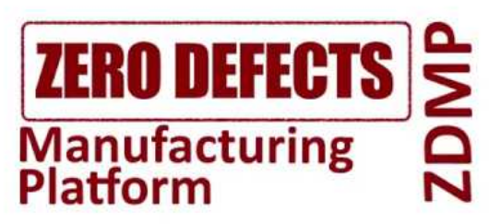

How to use the ZDM Platform
Notes:
Welcome to the training course devoted to the use of ZDM Platform.

Slide 2
Content
What is the ZDMP platform- for whom is this course and the general objectives
Technical specifications and requirements to have a running platform
How to use ZDMP Platform
Conclusions
Notes:
The content of the current course includes the following chapters: (i) introduction giving the understanding of what the ZDM platform, target audience and general objectives, (ii) technical specifications and requirements, (iii) how the ZDM platform can be used and the last chapter (iv) conclusions.

Slide 3
General Objectives and Target Audience
The objectives of the current document are the following:
To give an understanding of what the ZDM platform is;
Give an overview of the elements of the platform;
Present the architecture of the platform and explain the separation of the platform components on run- and design time;
Present the alignment of ZDM platform architecture to some reference models.
This document might be of particular interest for the following audience:
Manufacturing users who are seeking for the scalable, interoperable and modular solutions;
System integrators who are interested in bringing together disparate systems/components;
Developers who are interested in design of new zApps using the functionality offered by zComponents;
Students and teachers that can use ZDMP platform for educational purposes;
Researchers, who want to install and try the platform or some zComponents for their research;
Notes:
The objectives of the current training course include the following points:
To give an understanding of what the ZDM platform is;
Give an overview of the elements of the platform;
Present the architecture of the platform and explain the separation of the platform components on run- and design time;
Present the alignment of ZDM platform architecture to some reference models.
This document might be of particular interest for the following audience:
Manufacturing users who are seeking for the scalable, interoperable and modular solutions;
System integrators who are interested in bringing together disparate systems/components;
Developers who are interested in design of new zApps using the functionality offered by zComponents;
Students and teachers that can use ZDMP platform for educational purposes;
Researchers, who want to install and try the platform or some zComponents for their research.

Slide 4
ZDMP Alignment to IIoT architecture pattern
The result of the ZDMP alignment to the IIoT architecture pattern has the following structure:
Edge tier encompasses data acquisition and IIoT, since industrial sensors, actuators, and control data are the most relevant sources of information in ZDMP. Communication is bidirectional, since some of the use cases presented in the previous section presented the requirement to set up values on machines based on the results of analysis.
Platform tier has data harmonisation and Interoperability, AI and analytics, orchestration, monitoring, and alerting, although these functionalities can be decentralised and, to some extent, be available at the edge tier (i.e. Distributed and Autonomous Computing).
At the Enterprise tier are the ZDMP applications that use the different service APIs and implement the user interfaces. Platform Integration and Federation and Inter-Platform Interoperability exchange data with external services and also located at the enterprise tier.
NB: some aspects of the ZDMP Platform (e.g. application development and discovery) are external to the enterprise layer. Thus these aspects are considered outside of the three tier architectural model and correspondingly differentiated from the Enterprise layer.
Notes:
ZDM platform has strong relation to such concepts as Internet of Things and Cyber Physical Systems. In this regard, it is important to analyse some related reference models or architectures to see the similarities and differences. The results of the ZDMP alignment to the IIoT architecture pattern have the following structure:
Edge tier encompasses data acquisition and IIoT, since industrial sensors, actuators, and control data are the most relevant sources of information in ZDMP. Communication is bidirectional, since some of the use cases presented in the previous section presented the requirement to set up values on machines based on the results of analysis.
Platform tier has data harmonisation and Interoperability, AI and analytics, orchestration, monitoring, and alerting, although these functionalities can be decentralised and, to some extent, be available at the edge tier (i.e. Distributed and Autonomous Computing).
At the Enterprise tier are the ZDMP applications that use the different service APIs and implement the user interfaces. Platform Integration and Federation and Inter-Platform Interoperability exchange data with external services and also located at the enterprise tier.
Please, note that some aspects of the ZDMP Platform (e.g. application development and discovery) are external to the enterprise layer. Thus these aspects are considered outside of the three tier architectural model and correspondingly differentiated from the Enterprise layer.

Slide 5
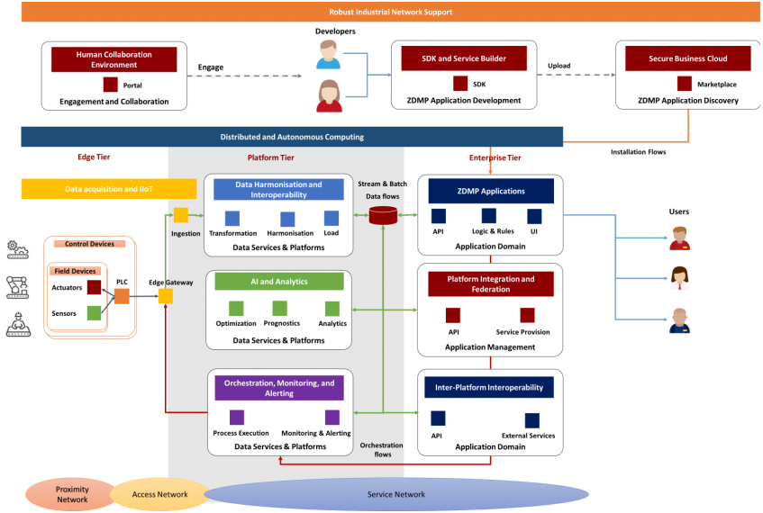
ZDMP Alignment to IIoT architecture pattern
Notes:
Here a tentative (non-binding) alignment of the main high-level functional blocks of the ZDMP system architecture to the IIoT architecture can be seen. The ZDMP platform provides a marketplace and Software Development Kit (SDK) to develop applications to realize the zero-defects manufacturing paradigm in manufacturing companies. The ecosystem is supported with a portal and engagement hub to promote the collaboration between stakeholders (mainly software developers and manufacturing companies). Some aspects of the ZDMP Platform (mainly development engagement, application development, and discovery) are external to the enterprise that instantiates the IIoT system and thus out of the scope of IIRA’s global architectural pattern.

Slide 6
Technical specifications
Notes:
The next chapter addresses the technical specifications of the ZDM platform.

Slide 7
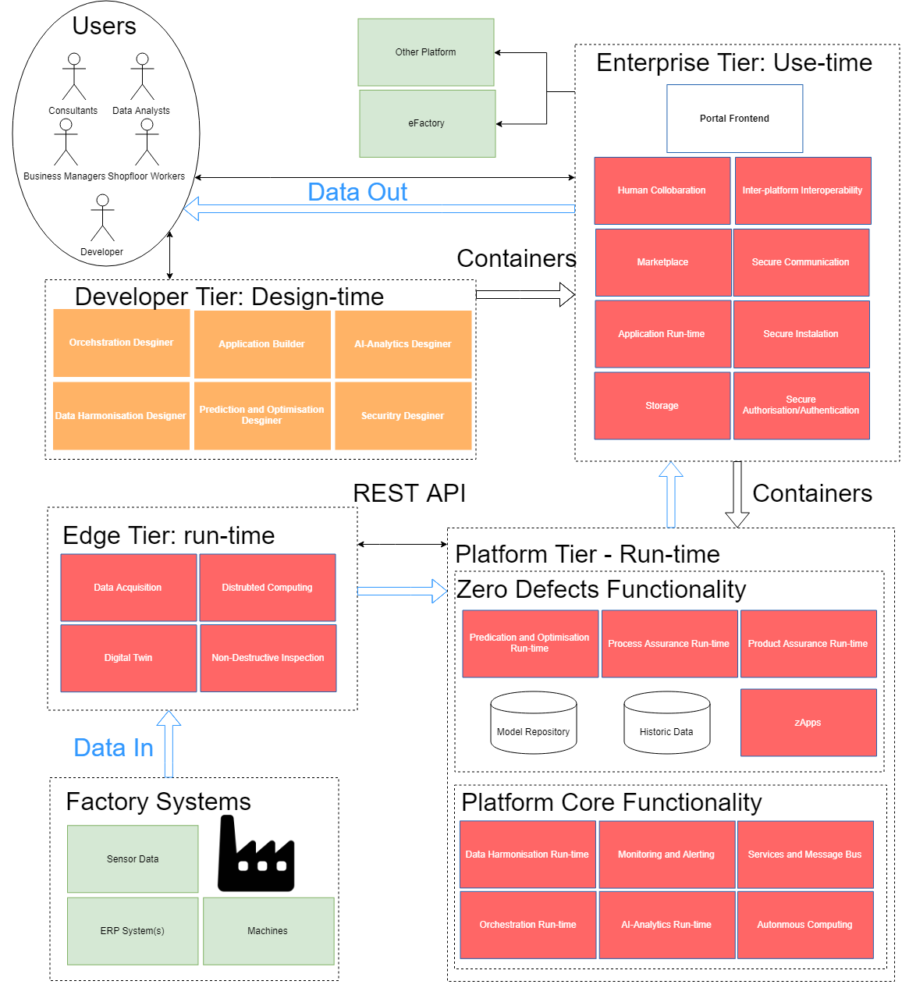
Architecture Overview
The boxes of the architecture have the following meaning:
• Red box: This box represents zComponents at run-time
• White box: This box represents the user interface of zComponent.
• Green box: This box represents external providers of certain tasks, e.g. an External Payment Provider or and External Messaging Provider
• Orange box: This box represents a zComponent from the Developer Tier that are used to design zApps
Notes:
The ZDM platform architecture consists of the four main blocks: (i) Enterprise Tier, (ii) Developer Tier, (iii) Platform Tier and (iv) Edge Tier. Moreover, the external entities, such as external platforms or factory systems providing data to the ZDM platform are considered in the current slide. The boxes of the architecture have the following meaning:
Red box: This box represents zComponents at run-time
White box: This box represents the user interface of zComponent.
Green box: This box represents external providers of certain tasks, e.g. an External Payment Provider or and External Messaging Provider
Orange box: This box represents a zComponent from the Developer Tier that are used to design zApps

Slide 8
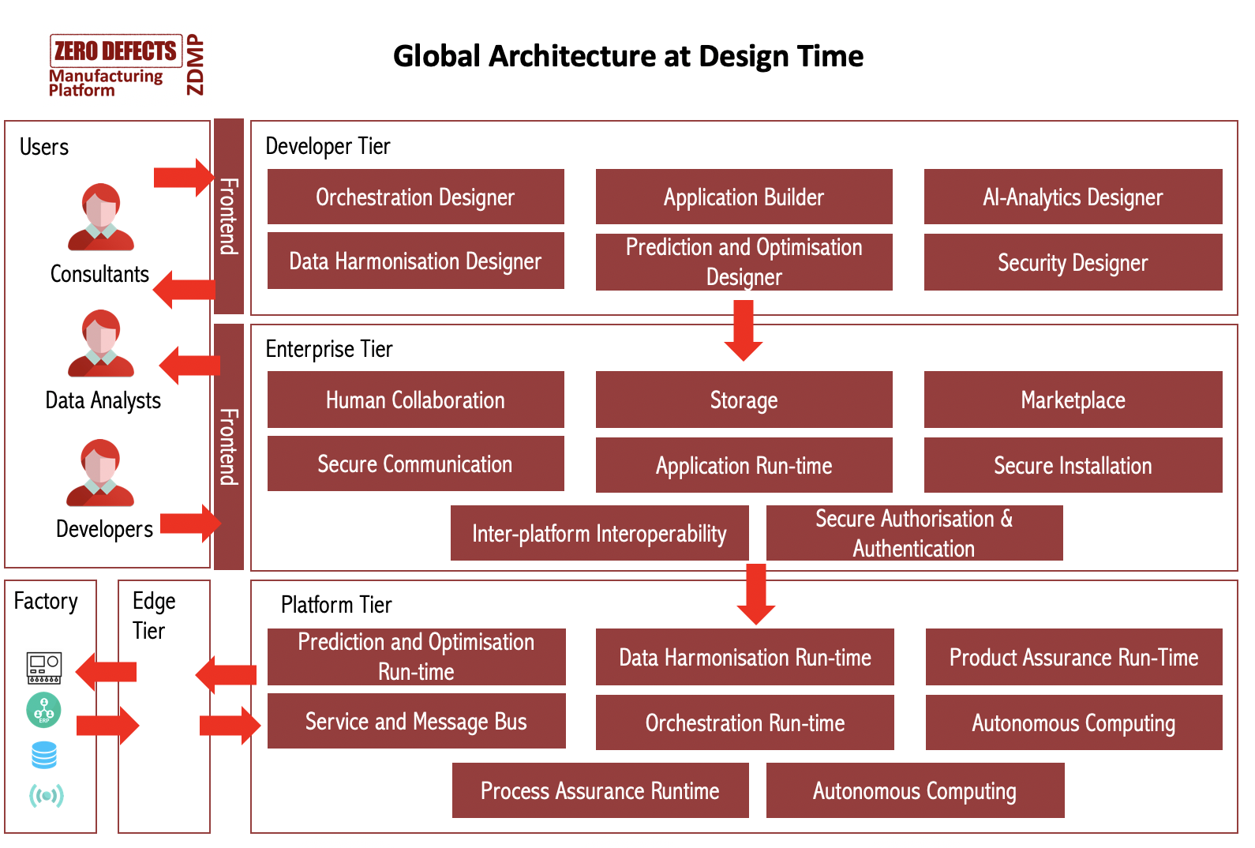
Architecture at Design Time
Notes:
All zComponents are divided onto run-, design- and use-time, while the use-time zComponents are rather the auxiliary components providing supporting functionality. Some zComponents are only design or run-time, other zComponents belong to both run- and design time, such as Data Harmonization component. The design time components are used to build a model that will be executed at run-time. An example can be the AI models that are build within AI-Analytics Designer, and afterwards are deployed using AI-Anlytics Runtime and fed with the real-time data acquired from edge devices installed in the industrial environment. Here, you can see the global architecture at design-time with corresponding zComponents.

Slide 9
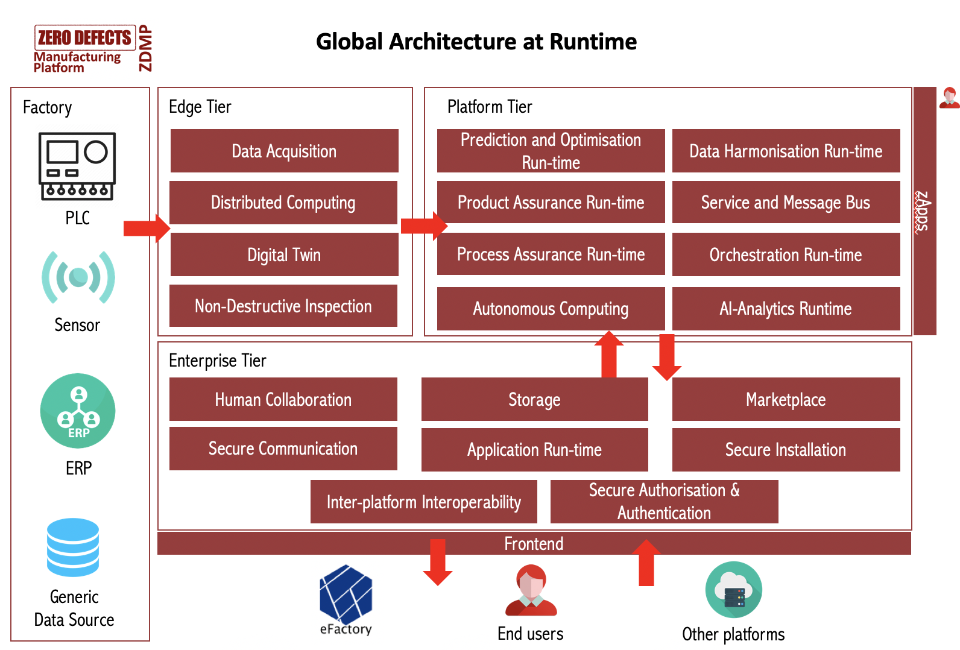
Architecture at Run-Time
Notes:
Here you can see the architecture at run-time with corresponding zComponents.

Slide 10
Technical Fondations of ZDMP Platform
Container first. Each component of ZDMP is designed and developed to be executed inside Docker containers.
Extensibility. Each docker container, or at least those which have something to share, are wrapped in an API, and documented using OpenAPI specification. Moreover, core functionalities can be extended by purchasing new components in the marketplace.
Distributed Architecture. Every component is designed to be executed in a distributed way. For that, ZDMP uses orchestration technologies like Docker Swarm and Kubernetes.
Composability. zComponents can be seen as building blocks, which can be composed in different manners. For that reason, ZDMP’s components are composable through a service and message bus.
Security. ZDMP includes several security controls, for instance: centralised authentication and authorisation, secure communications through SSL, continuously monitoring, etc.
Big Data and AI Driven. ZDMP provides infrastructure, tools and pipelines to support a wide catalog of AI models, which uses Big Data tools.
Connectivity. Ready to connect with the most used industry protocols.
Developer experience oriented. ZDMP provides several tools to ease the development of new components.
Interoperability. ZDMP can be connected to other platforms through the API’s.
Notes:
The core technical features can be summarized in the following bullet-points:
Container first. Each component of ZDMP is designed and developed to be executed inside Docker containers.
Extensibility. Each docker container, or at least those which have something to share, are wrapped in an API, and documented using OpenAPI specification. Moreover, core functionalities can be extended by purchasing new components in the marketplace.
Distributed Architecture. Every component is designed to be executed in a distributed way. For that, ZDMP uses orchestration technologies like Docker Swarm and Kubernetes.
Composability. zComponents can be seen as building blocks, which can be composed in different manners. For that reason, ZDMP’s components are composable through a service and message bus.
Security. ZDMP includes several security controls, for instance: centralised authentication and authorisation, secure communications through SSL, continuously monitoring, etc.
Big Data and AI Driven. ZDMP provides infrastructure, tools and pipelines to support a wide catalog of AI models, which uses Big Data tools.
Connectivity. Ready to connect with the most used industry protocols.
Developer experience oriented. ZDMP provides several tools to ease the development of new components.
Interoperability. ZDMP can be connected to other platforms through the API’s.

Slide 11
How to use ZDMP Platform
Notes:
The next chapter provides more details about the way of how to use the ZDM platform.

Slide 12
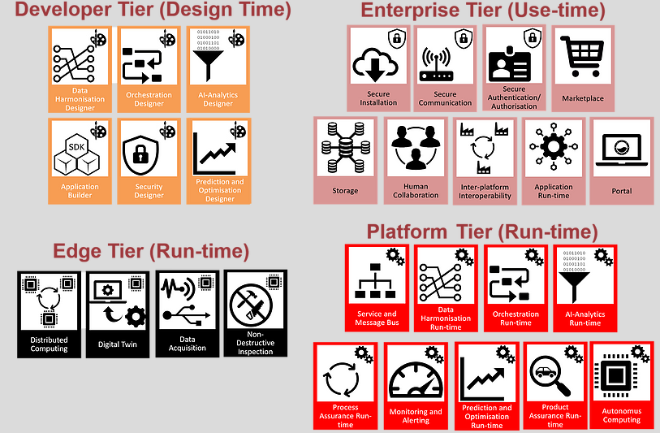
ZDM Platform zComponents
ZDM Platform is based on a federated architecture, which consists of several zComponents split into the following architectural building blocks:
Developer Tier (Design-time): These components aide in the production of containerised applications for zero defect manufacturing - zApps
Enterprise Tier (Use-time): These components assist the run-time
Platform Tier (Run-time): This is where zApps are installed. This component consists of run-time services to provide a base level functionality for ZDMP
Edge Tier (Run-time): This is composed of the Distributed Computing component, which allows certain zApps to be run at different locations of the system for performance gains
Notes:
Here you can see the generic view of ZDM platform’s architecture. The ZDMP is based on a federated architecture, which consists of several zComponents split into the following architectural building blocks:
Developer Tier (Design-time): These components aide in the production of containerised applications for zero defect manufacturing – zApps;
Enterprise Tier (Use-time): These components assist the run-time;
Platform Tier (Run-time): This is where zApps are installed. This component consists of run-time services to provide a base level functionality for ZDMP;
Edge Tier (Run-time): This is composed of the Distributed Computing component, which allows certain zApps to be run at different locations of the system for performance gains.

Slide 13
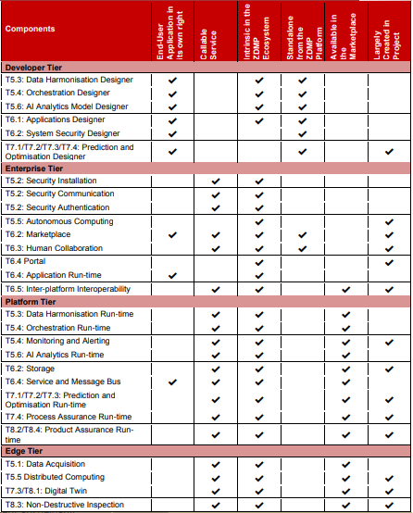
Types of zComponents
ZDMP deals with several types of zComponents, which are classified in respect to different qualities of each zComponent:
End-User Application in its Own Right: this means that the applications could be applied by a user although the application may still be dependent on other resources (APIs, etc).
Callable Service: typically, applications may be downloaded and put in a user environment; however, services may then be called as they may run solely in someone else’s environment – e.g. in another factory.
Intrinsic in the ZDMP Ecosystem: this implies that the project builds/buys this service/component and it would (always) form part of the platform
Standalone from the ZDMP Platform: some components may be run separately to the instance of the platform.
Available in the Marketplace
Largely Created in Project
Notes:
The main entities of the ZDM platform’s architecture are the zComponents that can belong to one of the 4 functional blocks mentioned before. ZDMP deals with several types of zComponents, which are classified in respect to different qualities of each zComponent:
End-User Application in its Own Right: this means that the applications could be applied by a user although the application may still be dependent on other resources (APIs, etc).
Callable Service: typically, applications may be downloaded and put in a user environment; however, services may then be called as they may run solely in someone else’s environment – e.g. in another factory.
Intrinsic in the ZDMP Ecosystem: this implies that the project builds/buys this service/component and it would (always) form part of the platform
Standalone from the ZDMP Platform: some components may be run separately to the instance of the platform.
Available in the Marketplace
Largely Created in Project

Slide 14
How to Install/Use ZDM Platform
ZDM platform is comprised of different zComponents providing different functionalities, more information about the available zComponents and how they are correlated with each other can be found at the official web page of ZDMP:
  https://www.zdmp.eu/documentation
  ZDM platform can be deployed both:
  Locally, in the local infrastructure
  On Cloud, in the cloud infrastructure
  Some documents that might be helpful in better understanding of ZDM platform are available in the following sections of ZDMP official web page:
  D4.3a: Global Architecture Specification – https://c53c19bc-6460-4dea-a74f-97b851e7af75.filesusr.com/ugd/851c99_0205c297a4b547bf8665daa36cf70984.pdf
  D2.4: Manufacturing Reference Model Analysis Document – https://c53c19bc-6460-4dea-a74f-97b851e7af75.filesusr.com/ugd/851c99_57042ac5fb6a4adea44bf9ff81010f5e.pdf
  D4.4a: Functional Specification – https://c53c19bc-6460-4dea-a74f-97b851e7af75.filesusr.com/ugd/f83381_dec67a7a414a4595bc92c107c0769704.pdf
Notes:
ZDM platform is comprised of different zComponents providing different functionalities, more information about the available zComponents and how they are correlated with each other can be found at the official web page of ZDMP.
ZDM platform can be deployed both:
Locally, in the local infrastructure;
On Cloud, in the cloud infrastructure.
Some documents that might be helpful in better understanding of ZDM platform are available in the following sections of ZDMP official web page Publications -> Outcomes:
D4.3a: Global Architecture Specification
D2.4: Manufacturing Reference Model Analysis Document D4.4a: Functional Specification
D4.4a: Functional Specification

Slide 15
Conclusions
Notes:
The final chapter contains the conclusions for the presented training course.

Slide 16
Conclusions
The ZDM platform has the federated structure, where zComponents create the backbone of platform offering the required functionality for its functioning.
All the details on how to install and use the ZDM Platform and namely zComponents including the zComponents that are vital for the functioning of other zComponents are explained in details at the official web page of ZDMP https://www.zdmp.eu/documentation
ZDM platform is comprised of run- and design time zComponents.
ZDM platform can be deployed both locally – in the local infrastructure, as well as in the cloud infrastructure.
Modular structure of ZDM Platform allows the user, besides “mandatory” zComponents, to select exact the zComponents that provide the necessary functionality.
Notes:
The following bullet points reveal the main ideas of the current training course:
The ZDM platform has the federated structure, where zComponents create the backbone of platform offering the required functionality for its functioning.
All the details on how to install and use the ZDM Platform and namely zComponents including the zComponents that are vital for the functioning of other zComponents are explained in details at the official web page of ZDMP https://www.zdmp.eu/documentation
ZDM platform is comprised of run- and design time zComponents.
ZDM platform can be deployed both locally – in the local infrastructure, as well as in the cloud infrastructure.
Modular structure of ZDM Platform allows the user, besides “mandatory” zComponents, to select exact the zComponents that provide the necessary functionality.

Slide 17
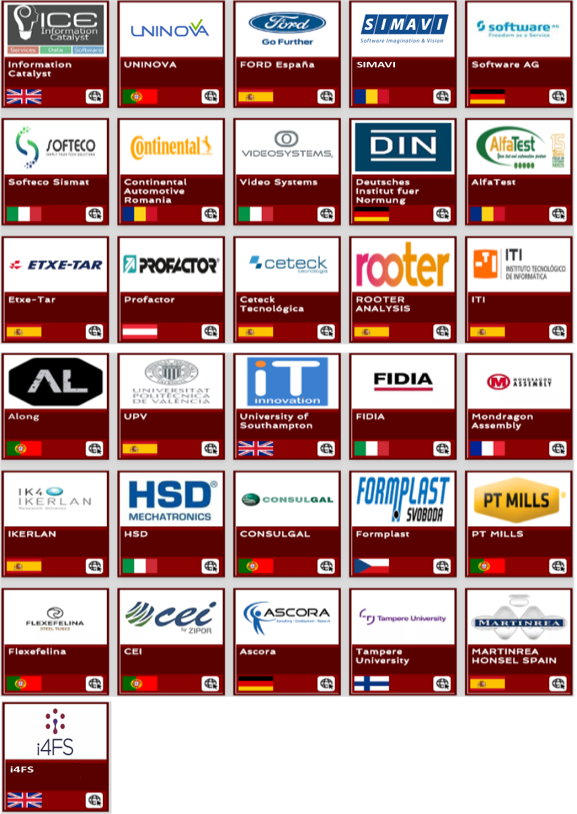
Thank You for watching
Funded by the Horizon 2020
Framework Programme of the European Union

