Slide 1



How to implement and use individual zComponents
Notes:
Welcome to the training course devoted to the use of the ZDMand implementation of zComponents.

Slide 2
Content
What is a zComponent – for whom is this course and the general objectives
Technical specifications and requirements to build/develop a zComponent
How to use a zComponent (with example)
Conclusions
Notes:
The content of this course includes the introduction explaining what zComponents are, who the target audience is and the general objectives, followed by technical specifications and requirements. Third chapter addresses the usage of zComponents, including small example of one zComponent. And the last chapter includes conclusive remarks. Moreover, at the end of each chapter there are the questions or true/false statements for the self control.

Slide 3
General Objectives and Target Audience
The objectives of the current document are the following:
To give an understanding of what are the zComponents and their relation to the ZDMP platform;
To show how zComponents are grouped based on specific qualities;
To explain where the user can get specific information on how to install (including the hardware and software requirements) and use the desired zComponents.
This document might be of particular interest for the following audience:
Manufacturing users who are seeking for the scalable, interoperable and modular solutions;
System integrators who are interested in bringing together disparate systems/components;
Developers who are interested in design of new zApps using the functionality offered by zComponents;
Students and teachers that can use ZDMP platform for educational purposes;
Researchers, who want to install and try the platform or some zComponents for their research;
Notes:
The objectives of the current training course include the following points:
To give an understanding of what are the zComponents and their relation to the ZDMP platform;
To show how zComponents are grouped based on specific qualities;
To explain where the user can get specific information on how to install (including the hardware and software requirements) and use the desired zComponents.
The target audience, in its turn, includes the following groups:
Manufacturing users who are seeking for the scalable, interoperable and modular solutions;
System integrators who are interested in bringing together disparate systems/components;
Developers who are interested in design of new zApps using the functionality offered by zComponents;
Students and teachers that can use ZDMP platform for educational purposes;
Researchers, who want to install and try the platform or some zComponents for their research.

Slide 4
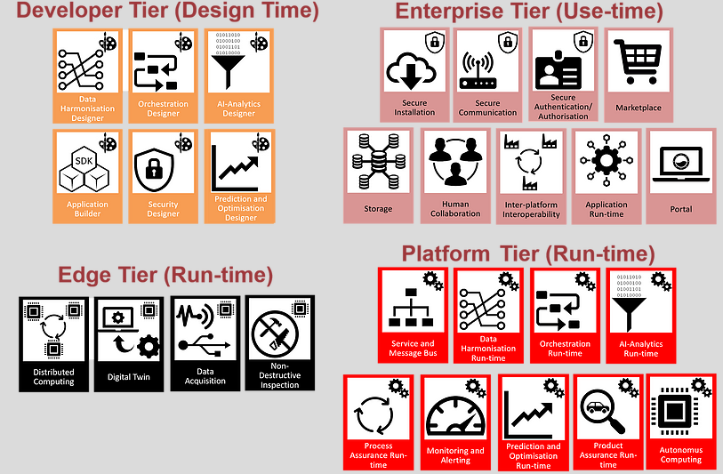
Architecture Overview
ZDMP is based on a federated architecture, which consists of several zComponents split into the following architectural building blocks:
Developer Tier (Design-time): These components aide in the production of containerised applications for zero defect manufacturing - zApps
Enterprise Tier (Use-time): These components assist the run-time
Platform Tier (Run-time): This is where zApps are installed. This component consists of run-time services to provide a base level functionality for ZDMP
Edge Tier (Run-time): This is composed of the Distributed Computing component, which allows certain zApps to be run at different locations of the system for performance gains
Notes:
To better understand what the zComponents are it is important to get acquainted with the overall architecture of ZDM platform. The ZDMP is based on a federated architecture, which consists of several zComponents split into the following architectural building blocks:
Developer Tier (Design-time): These components aide in the production of containerised applications for zero defect manufacturing - zApps
Enterprise Tier (Use-time): These components assist the run-time
Platform Tier (Run-time): This is where zApps are installed. This component consists of run-time services to provide a base level functionality for ZDMP
Edge Tier (Run-time): This is composed of the Distributed Computing component, which allows certain zApps to be run at different locations of the system for performance gains
The components’ groups are also split into run-, design- and use-time. Design-time components are used to create models that are then executed at the run-time. The Use-time components can be described as auxiliary, providing some assistive functionality for the other components and ZDM platform itself.

Slide 5
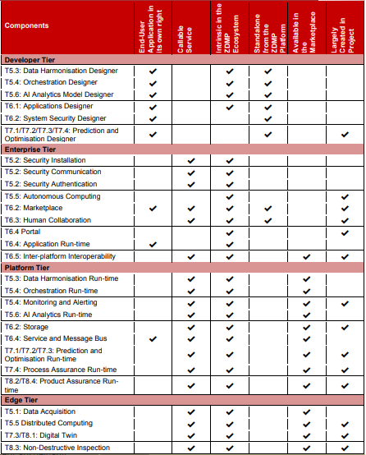
Types of zComponents
ZDMP deals with several types of zComponents, which are classified in respect to different qualities of each zComponent:
End-User Application in its Own Right: this means that the applications could be applied by a user although the application may still be dependent on other resources (APIs, etc).
Callable Service: typically, applications may be downloaded and put in a user environment; however, services may then be called as they may run solely in someone else’s environment – e.g. in another factory.
Intrinsic in the ZDMP Ecosystem: this implies that the project builds/buys this service/component and it would (always) form part of the platform
Standalone from the ZDMP Platform: some components may be run separately to the instance of the platform.
Available in the Marketplace
Largely Created in Project
Notes:
Moreover, ZDMP deals with several types of zComponents, which are classified in respect to different qualities of each zComponent:
End-User Application in its Own Right: this means that the applications could be applied by a user although the application may still be dependent on other resources (APIs, etc).
Callable Service: typically, applications may be downloaded and put in a user environment; however, services may then be called as they may run solely in someone else’s environment – e.g. in another factory.
Intrinsic in the ZDMP Ecosystem: this implies that the project builds/buys this service/component and it would (always) form part of the platform
Standalone from the ZDMP Platform: some components may be run separately to the instance of the platform.
Available in the Marketplace
Largely Created in Project

Slide 6
Technical specifications
Notes:
The following chapter provides the brief overview over the technical specifications.

Slide 7
Requirements to use zComponents
Documentation, available on the official web page of ZDMP (https://www.zdmp.eu/documentation), of every zComponent has specific section with the hardware and software requirements for every component. An example of minimum requirements for the Data Harmonisation Designer is provided below:
  Docker
  A desktop Linux, or Windows PC with these minimum resources:
  4 CPUs
  8 GB RAM
  5 GB+ Disk Space
  A way to extract ZIP files
One specific feature that is relevant for all zComponents is component dockerization.
Notes:
Each zComponent has documentation, available on the official web page of ZDMP (you can see the link), containing specific section with the hardware and software requirements for every zComponent. Here you can see an example of minimum requirements for the Data Harmonisation Designer:
Docker
A desktop Linux, or Windows PC with these minimum resources:
4 CPUs
8 GB RAM
5 GB+ Disk Space
A way to extract ZIP files
One specific requirement that can be applied to all zComponents is the component dockerization.

Slide 8
Requirements to use zComponents
In some cases zComponents can be run in stand alone mode. However in some cases, to be able to use certain zComponents, the user needs to install other zComponents that are required for the functioning of the selected zComponent. Moreover, there might be some zComponents that are optional for the selected zComponent allowing to enrich its functionality. An example here can be the Data Harmonisation Designer and Runtime that has no required zComponents for the normal operation and on the other hand Data Acquisition component that has the following associated zComponents:
  Required zComponents:
  T6.4 Service and Message Bus
  T5.2 Secure Authentication and Authorisation
  Optional zComponents:
  T6.3 Storage
  T6.4 Portal
  The User should always pay attention to the associated components, that are mentioned in the corresponding section (Associated ZDMP services) of the zComponents’ Documentation available at https://www.zdmp.eu/documentation
Notes:
In some cases zComponents can be run in standalone mode. However in some cases, to be able to use certain zComponents, the user needs to install other zComponents that are required for the functioning of the selected zComponent. Moreover, there might be some zComponents that are optional for the selected zComponent allowing enriching its functionality. An example here can be the Data Harmonisation Designer and Runtime that has no required zComponents for the normal operation and on the other hand Data Acquisition component that has the following associated zComponents:
Required zComponents:
T6.4 Service and Message Bus
T5.2 Secure Authentication and Authorisation
Optional zComponents:
T6.3 Storage
T6.4 Portal
The User should always pay attention to the presence of associated zComponents, that are mentioned in the corresponding section (Associated ZDMP services) of the zComponents’ Documentation.

Slide 9
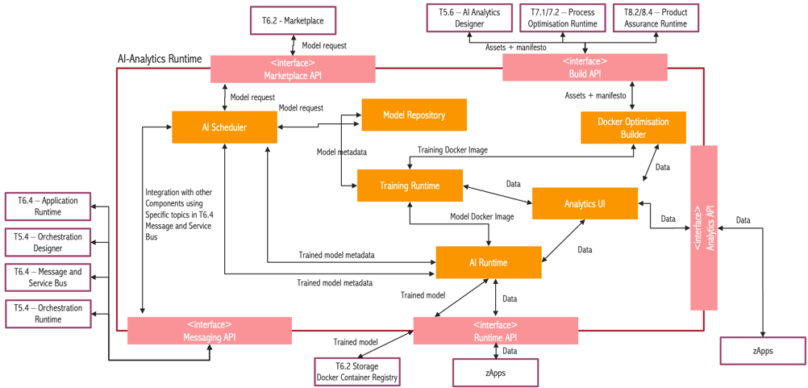
Component AI Analytics Runtime
Notes:
Every zComponent has its own architecture, and every architecture is composed of several subsystems. The technology used in the component is not important from an integration perspective point of view to be applicable for a wide variety of use-cases. Here you can see the example scenario of the AI-Anlytics run-time component with other involved zComponents.

Slide 10
How to use a zComponent
Notes:
The next chapter addresses the issue of zComponents utilization including a small example.

Slide 11
Installation of zComponents
Documentation available at the official ZDMP (https://www.zdmp.eu/documentation) web page offers instructions on how to install and use zComponents. An example on how to install the Data Harmonisation Designer is provided below:
  Go to ZDMP Gitlab repository and find “Data Harmonisation” project.
  Find the ZIP file “IDP-Installer-[release -details]-V7.2.1.zip”
  Download the file and extract it to a location of the choice.
  When extracted, the user should have a folder with the same name as the ZIP file
  Run “TOS_DI-win-x86_64.exe” which runs the ICE Data Platform
Notes:
Documentation available at the official ZDMP web page offers detailed instructions on how to install and use every zComponents. Here you can see an example on how to install the Data Harmonisation Designer is provided below:
Go to ZDMP Gitlab repository and find “Data Harmonisation” project;
Find the ZIP file “IDP-Installer-[release -details]-V7.2.1.zip”;
Download the file and extract it to a location of the choice;
When extracted, the user should have a folder with the same name as the ZIP file;
Run “TOS_DI-win-x86_64.exe” which runs the ICE Data Platform.

Slide 12
How to Use zComponents
Detailed examples on how to utilize every zComponent are available from the documentation section at the official ZDMP web page (https://www.zdmp.eu/documentation). In order to illustrate how zComponents can be used, an example of utilization of a Data Acquisition offering the following functionality is provided:
  Register devices manually and or bulk-register devices
  Browse registered devices, grouping devices into top-level groups and subgroups.
  View and configure device details
  Monitor and control devices, including connection quality and service status of devices
  Handle alarms from devices. Remote control and troubleshoot devices.
  Manage device data, retrieving and managing firmware and software for devices.
  Retrieve configuration data and store and manage it in a configuration repository as configuration snapshots
Notes:
To mention again, the detailed examples on how to utilize every zComponent are available from the documentation section at the official ZDMP web page. In order to illustrate how zComponents can be used, an example of utilization of a Data Acquisition offering the following functionality is provided:
Register devices manually and or bulk-register devices
Browse registered devices, grouping devices into top-level groups and subgroups.
View and configure device details
Monitor and control devices, including connection quality and service status of devices
Handle alarms from devices. Remote control and troubleshoot devices.
Manage device data, retrieving and managing firmware and software for devices.
Retrieve configuration data and store and manage it in a configuration repository as configuration snapshots
Important is to mention that the user can look for the functionality she/he needs (the features section within documentation on ZDMP official web page) and select the zComponents and associated ones if available that offer this functionality avoiding the need to use/install all zComponents. Based on the functional blocks offered by zComponents, developers can create a customized zApps targeting specific problems immanent to specific manufacturing areas.

Slide 13
zComponent Usage Example
Notes:
The small example demonstrating the usage of Data Acquisition zComponent is presented in the slides below.

Slide 14
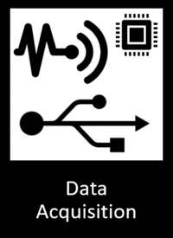
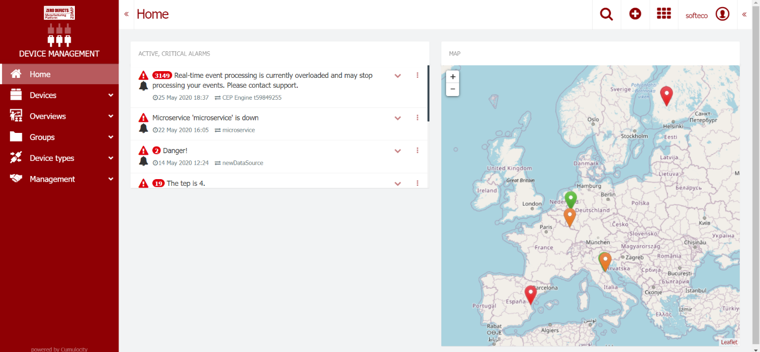
Register a new data source (device)
Data Source registration and management functionality are available through a main Cumulocity Cockpit control panel provided by the customized UI. More information on how to use Cumulocity User Interface can be found: https://cumulocity.com/guides/users-guide/getting-started/#gui-features
Notes:
Data Source registration and management functionality are available through a main Cumulocity Cockpit control panel provided by the customized UI. More information on how to use Cumulocity User Interface can be found at the official web page of Cumulocity. Thus, user of Data Acquisition zComponent gets the UI to add/edit/remove new resources (e.g. sensors) and check the status of them.

Slide 15
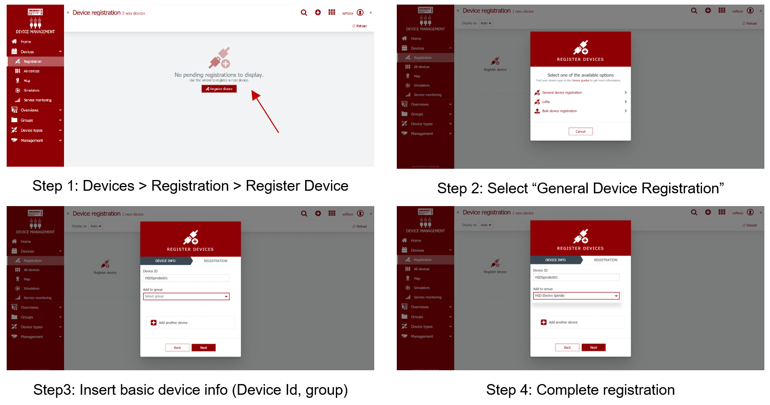
Register a new data source (device)
To register a new device with the system, from the main control panel select from the left-side menu the option: Devices > Registration
Notes:
To register a new device with the system, from the main control panel select the option Devices > Registration from the left-side menu. Devices can also be registered through a bulk registration, i.e. the registration of a large number of devices at the same time by uploading a CSV file containing the related information. After this step, the Device registration page will show a list of all devices, which are currently in the registration process, shown with a status icon representing the current registration status. The registration is complete when a device with the specified Id successfully manages to connect to the platform.

Slide 16
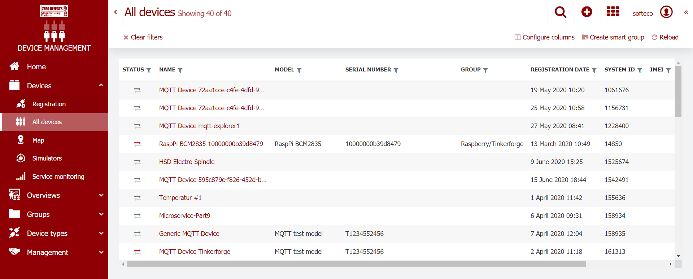
View and manage data sources
From the left-side menu in the main Cockpit application, a list of the currently registered devices can be shown by the option: Devices > All devices
Notes:
To see all currently available or registered devices user has to select from the left-side menu in the main Cockpit application “Devices” and then “All devices” option. Afterwards, user will see the list of devices including additional information, if available, about the model of device, its serial number, its name, registration date or even the group name (in the case device is assigned to a certain group).

Slide 17
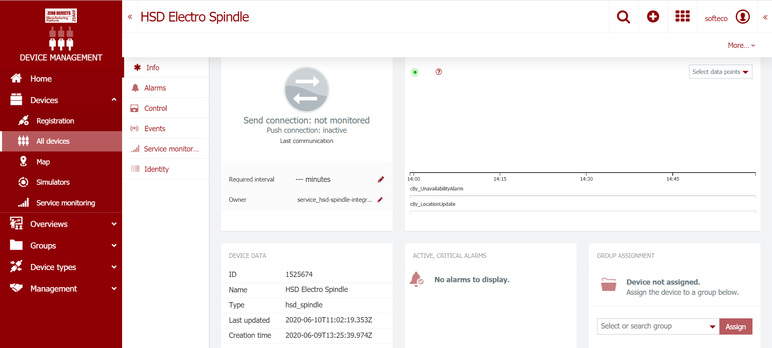
View and manage data sources
By clicking on the device name, it is possible to access the device management control panel, where registration information, device data, status, alarms, or event information is displayed:
Notes:
By clicking on the device name, it is possible to access the device management control panel, where registration information, device data, status, alarms, or event information is displayed. Other data source management functionality is accessible through the left-side menu item: “Groups” where devices can be assembled into groups according to several business criteria.

Slide 18
Service monitoring
The status of a device connection can be monitored via the Device Management panel shown above. A required interval can be configured to define how often it is expected to receive a message from a given source. If, for example, the required interval is set to 60 (minutes), the device is expected at least to communicate once in an hour with the platform. The interval is either set by the device itself, based on the device’s internal settings, or it is set manually via the management interface. The device can be in one of the following statuses:
Online (data was sent within the required interval), indicated by a green arrow in the UI
Offline (data was not sent within the required interval), indicated by a red arrow
Unknown or not monitored (no interval configured), indicated by a grey arrow
Notes:
The status of a device connection can be monitored via the Device Management panel shown above. A required interval can be configured to define how often it is expected to receive a message from a given source. If, for example, the required interval is set to 60 (minutes), the device is expected to communicate, at least, once in an hour with the platform. The interval is either set by the device itself, based on the device’s internal settings, or it is set manually via the management interface. The device can be in one of the following statuses:
Online (data was sent within the required interval), indicated by a green arrow in the UI
Offline (data was not sent within the required interval), indicated by a red arrow
Unknown or not monitored (no interval configured), indicated by a grey arrow
When a device is detected to be offline (i.e. it stops sending data within required interval and top arrow changes to red colour), an unavailability alarm is created for the device: “No data received from device within required interval”.
Moreover, the device may be in “Maintenance” mode. This is a special connection status indicating that the device is currently being maintained and cannot be monitored. Whilst a device is being maintained, no alarms for that device are raised.

Slide 19
Conclusions
Notes:
The last chapter of the course provides conclusions.

Slide 20
Conclusions
The ZDM platform has the federated structure, where zComponents create the backbone of platform offering the required fucntionality for its functioning.
All the details on how to install, as well as examples of utilization of zComponents are available at the official web page of ZDMP https://www.zdmp.eu/documentation
The functionalities offered by zComponents can be extended through the zApps relying on zComponents as foundation.
The user groups that might be interested in utilization of ZDM platform and zComponents cover both industry and academia.
The services provided by zComponents are exposed as Docker Containers contributing .
Notes:
The following bullet points reveal the main ideas of the current training course:
The ZDM platform has the federated structure, where zComponents create the backbone of platform offering the required fucntionality for its functioning.
All the details on how to install, as well as examples of utilization of zComponents are available at the official web page of ZDMP https://www.zdmp.eu/documentation
The functionalities offered by zComponents can be extended through the zApps relying on zComponents as foundation.
The user groups that might be interested in utilization of ZDM platform and zComponents cover both industry and academia.
The services provided by zComponents are exposed as Docker Containers contributing.

Slide 21
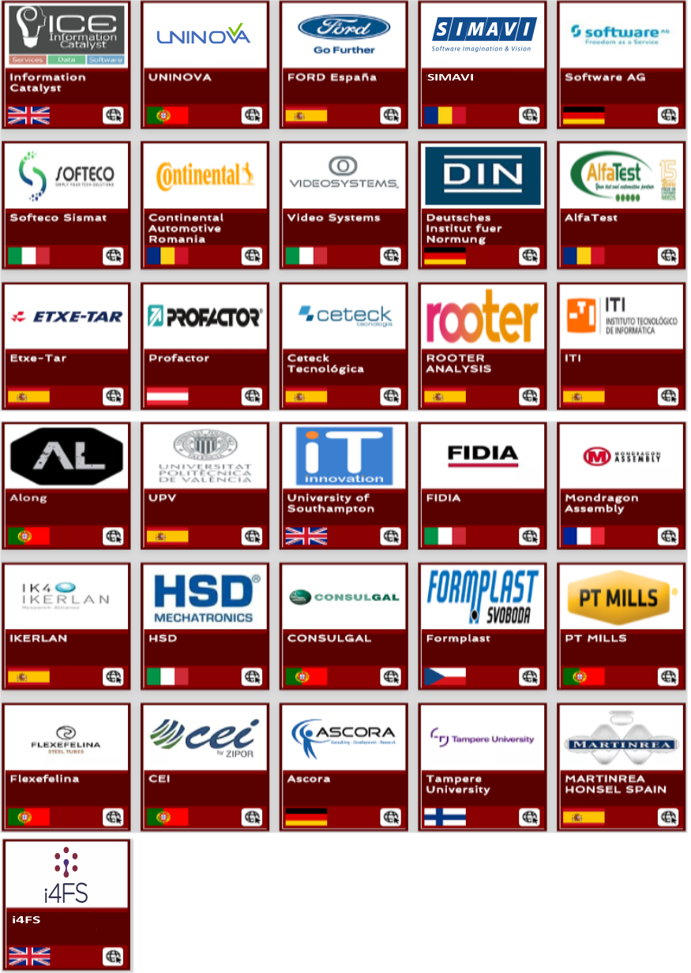
Thank You for watching
Funded by the Horizon 2020
Framework Programme of the European Union

