Slide 1



Business Exploitation of a zAsset for subcalls
Notes:
Welcome to the “ZDMP – Open Call Guidance” module! …

Slide 2
Index
Objectives of the course
What is ZDMP and what can offer to the stakeholders
What is a zComponent
What is a zApp
Aspects to be considered before exploitation
Exploitation of the Results
IP Management
Conclusions
Notes:
First of all I will introduce the main points that I'm going to present during this meeting session

Slide 3
Objectives of the course
To learn ZDMP’s value proposition and the business opportunities that it offers
To learn the difference between zApps and zComponents
To learn the aspects that should be analysed to determine the value proposition of the sub-project results and to define the business model for its exploitation
To learn the most common exploitation modes for zApps and zComponents
Learn the main aspects of IP Management that should be implemented for an appropriate exploitation of the sub-project results
Notes:
The main objectives of this course are the following ( mention the ones in the slide)

Slide 4
ZDMP
What is ZDMP?

Slide 5
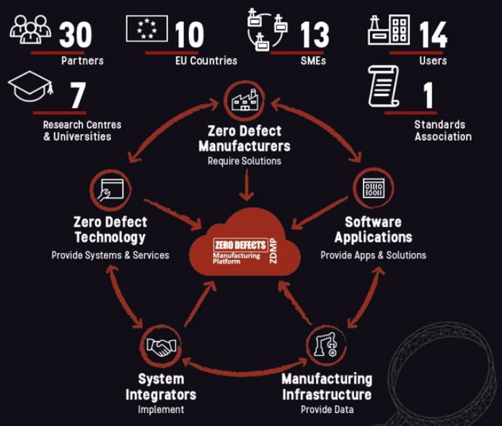
What is ZDMP?
Zero Defects Manufacturing Platform (ZDMP) is a multi-partner project that aims at providing an open platform to support factories to reach a zero defects goal.
ZDMP allows end-users to interconnect their systems (e.g., shop floor and ERP Systems) through ZDMP Applications, zApps, to improve product and process quality assurance.
Notes:
ZDMP aims at providing such an extendable platform for supporting factories to reach the goal of zero-defect production. In this context, ZDMP will allow end-users to connect their systems (ie shop-floor and Enterprise Resource Planning systems) to benefit from the features of the platform. These benefits include product and production quality assurance amongst others. For this, the platform provides the tools to allow following each step of production, using data acquisition to automatically determine the functioning of each step regarding the quality of the process and product. With this, it is possible to follow production order status and optimize the overall processes regarding time constraints and product quality, achieving the zero defects.

Slide 6
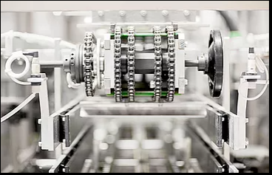
ZDMP – Main Goal and Mission
The main goal of ZDMP is to develop a Smart, SME Friendly, Open, Zero-Defect Manufacturing Reference Platform, Apps, SDK, and Marketplace for Product and Process Quality in any factory for achieving excellence in European and Global Manufacturing.
Its mission is to develop and establish a digital platform and related Apps for achieving excellence in manufacturing through zero defect processes and products.
Notes:
This slide presents the main goal and also the mission of ZDMP … ( same narrartive that in the slide)

Slide 7
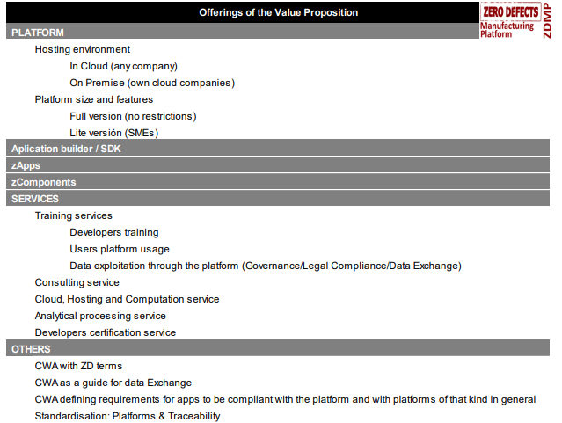
ZDMP – Value proposition
Notes:
Within the table above, the value proposition extracted is essentially the list below and for
• Platform: A fully developed version of the Platform will be available and hosted InCloud. The same or customised version of the Platform and its ecosystem will be
ready to be installed at any customer premises – aka OnPremise. The aim in this case is to provide private instances of the Platform for large manufacturing
companies or SMEs clusters who may have privacy/security concerns. As the enveloping concept this also represents the business as a whole
• Marketplace: An Apple iTunes Store or Google Play-like marketplace will be provided with similar buy/sell functionality and all that goes around it. However, the
products being marketed with will be dramatically different since they will be software applications for factories, especially SMEs. It will include a functionality for requesting
new Smart Applications. This represents the sells side of the multisided platform
• Application Builder (zStudio): A complete and open development kit will be provided targeting the software producing community. The aim is to guarantee the
growth of specific applications running across all industrial sectors and scenarios including those beyond the baseline projects. This has previously been/is also known
as the ZDMP Development Environment/SDK/Application runtime. This represents the support for the technology partners who offer to the Marketplace
• Applications (zApps): A set of smart manufacturing applications fully customized addressing customers’ needs and requests. In the context of ZDMP these
applications focus on areas related to zero-defects. This represents primarily the support for the technology partners who offer to the Marketplace but also covers the
cases where the Platform Owner or other entities provide zApps. It represents the supply side
• Components (zComponents): A set of modules that provide interfaces to physical or digital assets, and the callable services for data processing, analytics, and other
functionality. The aim is to allow the fast and easy adoption of the Platform by thexend users focusing on customised zApps according to their needs, the connection of
these with in-house systems and advanced data processing algorithms. It representsxthe supply side
• Services (zServices): A set of integrated services that enhance the Platform usage and acceptance based on the guaranteed quality of service in hosting and
computation processing and consulting services for zApps customisation and developers training. It represents the supply side

Slide 8

ZDMP – Benefits for Users’ Group
Manufacturing users can ask for new applications and algorithms or find existing ones from the marketplace to solve their own zero-defect manufacturing problems
Software developers can both respond to specific manufacturing user demands and self-innovate to design, build, and publish new applications and algorithms
Service providers will interact offering infrastructure for communications, storage, and processing
Consulting companies can interact as prescriber of the ZDMP solutions giving support to their customers.
Zero-defect technology companies can provide the marketplace with drivers and APIs to access to access their technical equipment
Notes:
ZDMP will offer an open environment where a new generation of developed zero-defect service applications will be available in a marketplace contributing to create an ecosystem where ZDMP stakeholders would be able to interact with each other. In this ecosystem:
•Manufacturing users can ask for new applications and algorithms or find existing ones from the marketplace to solve their own zero-defect manufacturing problems
•Subscribed software developers can both respond to specific manufacturing user demands and self-innovate to design, build, and publish new applications and algorithms
•Service providers will interact offering infrastructure for communications, storage, and processing
•Consulting companies can interact as prescriber of the ZDMP solutions giving support to their customers
•Zero-defect technology companies can provide the marketplace with drivers and APIs to access to access their technical equipment

Slide 9
ZDMP
What is a zComponent?

Slide 10
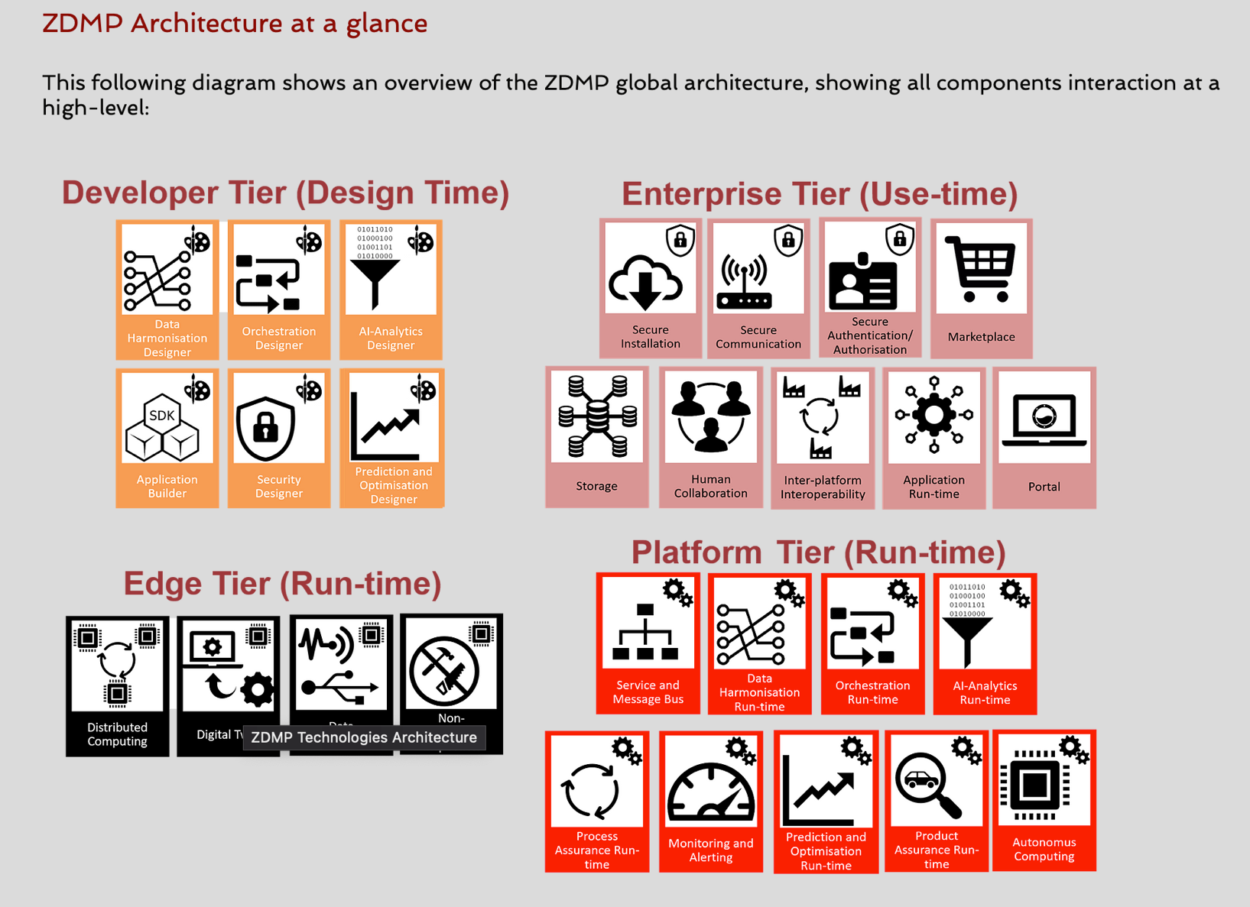
ZDMP is a wide platform and is thus a suite of components that deploys and enables the ecosystem functionalities
zComponents building blocks
Notes:
ZDMP-Platform is based on a federated architecture, which consists of several components split into the following architectural building blocks:
• Developer Tier (Design-time): These zComponents aide in the production of containerised applications for zero defect manufacturing - zApps
• Enterprise Tier (Use-time): These zComponent assist the run-time
• Platform Tier (Run-time): This is where zApps are installed. This zComponent consists of run-time services to provide a base level functionality for ZDMP
• Edge Tier (Run-time): This is composed of the Distributed Computing zComponent which allows certain zApps to be run at different locations of the system for
performance gains

Slide 11
What is a zComponent
A software package, a web service, a web resource, or a module that encapsulates a set of related functions or data
May run OnPremise, InCloud, or both
Enable re-usability such that programmers can design and implement software, both zApps and further components, in such a way that many different programs can reuse them
Modular and inked together via their API to allow integration with 3rd party systems/services and provide interoperability with other platforms
Whilst ZDMP project provides an initial set of valuable components this set will be improved over time dependent on demand
Notes:
A ZDMP(software) component has the same definition as with the common pseudo definition of a software component; ie a software package, a web service, a web resource, or a module that encapsulates a set of related functions or data. The component may run onPremise, InCloud, or most beneficially both. All primary generic features that ZDMP supports are placed into separate components so that all of the data and functions inside each component are semantically related (just as with the contents of classes). The components enable re-usability such that programmers can design and implement software, both zApps and further components, in such a way that many different programs can reuse them The components are thus modular and are linked together via their APIs primarily through a (ZDMP) message bus but direct API-API connectivity is possible. (zero), one or many of these components can be primarily used to build ZDMP Applications or secondarily further ZDMP components. Given the components are tuned to the ZDMP environment component substitutability is not a primary feature for building zApps/Components however from system perspective the ZDMP are substitutable by, for example, new versions of the same ZDMP components within zApps. ZDMP components are utilised by developers and not users. Whilst the ZDMP project provides an initial set of valuable components this set will be improved over time dependent on demand. To enable the functionality components will include code and the non-inclusive combination of frontends (admin / user), backends, databases, etc

Slide 12
ZComponents examples of functionalities
To build applications that monitor, manage, and control connected devices
To collect and analyse data from connected devices
To enable secure connectivity and privacy between devices and throughout the platform
To manage interconnectivity from device/sensors, to machines, to factories, to partners
To offer core API services to facilitate use
To allow integration with 3rd party systems/services and provide interoperability with other platforms
To automate and provide services for the intelligent zero-defects ecosystem of the platform.
Notes:
ZDMP is that platform and is thus a suite of components that deploys and enables the ecosystem:
To build applications that monitor, manage, and control connected devices
To collect and analyse data from connected devices
To enable secure connectivity and privacy between devices and throughout the platform
To manage interconnectivity from device/sensors, to machines, to factories, to partners
To offer core API services to facilitate use
To allow integration with 3rd party systems/services and provide interoperability with other platforms
To automate and provide services for the intelligent zero-defects ecosystem of the platform

Slide 13
ZDMP
What is a zApp?

Slide 14

What is a zApp
zApps are end user solutions, running on factory servers, desktop or mobile clients
zApps InCloud and/or OnPremise
Most usually zApps will include at least one ZDMP Component
To enable the functionality components will tipically include code and frontends (admin / user) although not compulsory, backends, databases
Notes:
zApps are end user solutions, running on factory servers, desktop or mobile clients, InCloud and/or OnPremise and connected to / dependent on / including 0..n ZDMP components as well as other code. Most usually zApps will include at least one ZDMP Component. Despite the name ‘Apps’ this is not intended to infer only ‘mobile-like’ applications and most likely in factory settings zApps will not be mobile orientated by maybe – tablet, smart phone etc. Within the context of ZDMP each zApp will naturally enable to at least some extent improvement/monitoring/… of product, process or other quality aspects. zApps can be vertically or horizontally orientated (ie general purposes in a zero-defect context) or vertically orientated (ie designed for a specific domain or business). To enable the functionality components will include code and frontends (admin / user) although not compulsory, backends, databases, etc although most likely there will being activities are addressed in this slide …

Slide 15
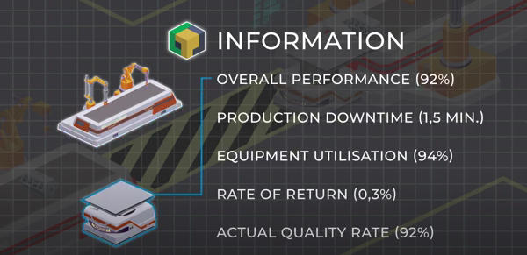
How do zApps work?
zApps are composed using the projects SDK and different components
Information is received from sensors/APIs and then processed the data
Data is processed through Process and Product Analytics Services which in turn feeds back to the Apps to complete the cycle reiterating until the system is optimized
Notes:
ZDMP Apps are composed using the projects SDK and different components. Broadly these receive (and present/actuate) information from sensors/APIs and then process the data. Influencing this are material and process flaws as well as errors which create defects. This data is processed through Process and Product Analytics Services which in turn feeds back to the Apps to complete the cycle reiterating until the system is optimised and Zero-Defect Product is achieved. ZDMP is that platform and is thus a suite of components that deploys and enables the ecosystem:

Slide 16
ZDMP
Aspects to be considered before explotation

Slide 17

Aspects to be considered before exploitation
  How are you going to exploit the result ( research, education, market, service, standard, licensing, internally)
  Customer segment expected to be reached
  Geographical area
  Customer characteristics (sector, size, etc)
Notes:
These aspects should be analyse to extract the value proposition of the subproject results as well as to define the exploitation plan (mention all of them)

Slide 18
Aspects to be considered before exploitation
  Problems and needs of the cutomers that you are solving
  Value with regard to competitors (eg price, novelty, brand, quality, specific functionality, easy-to-use, customization, risk reduction)
  Communication and distribution channels to be used (eg sales force, website, prescribers)
  Expected relationship with different customer segments (eg personal assistance, self-service, communities, fidelity programs, co-creation)

Slide 19
Aspects to be considered before exploitation
  Pricing model (eg hourly rate, free, individual, and customized pricing, open-source license, fee based on spent effort, order contracts based on value offered, fixed price or offering per request)
  Key activities needed for its commercialization, licensing, etc
  Key resources and costs required
Notes:
Same narrative than in the previous slide

Slide 20
ZDMP
Time to exploit

Slide 21
Subcall contractual conditions
  Sub-project winners will own the outputs of their Open Call activity and will be free to exploit them across their business
  Where relevant, sub-projects will host outputs on the ZDMP Marketplace free of charge, both for the third party and for the ZDMP project, for one year after the end of the project
  Applicable subcall software results must be exploited through i4FS Marketplace exclusively (zComponents, zApps) for one year after the end of the project (exclusivity affects exploitation in other marketplaces)
  Hosting will be subject to bilateral negotiations where all costs will need to be part of the hosting agreements between the sub-project parties and the i4FS
Notes:
Sub-project winners will own the outputs of their Open Call activity (eg zApps, components, validation results, testing methodologies, and/or integrated services) and will be free to exploit them across their business
Where relevant, sub-projects will host outputs on the ZDMP Marketplace free of charge, both for the third party and for the ZDMP project, for one year after the end of the project with any Marketplace sales generating revenue for the sub-project’s business and commission for the ZDMP Marketplace
Applicable subcall software results must be exploited through i4FS Marketplace exclusively (zComponents, zApps) for one year after the end of the project. This limitation only affects availability of the result in other marketplaces; other modalities of exploitation are allowed (eg the Subcall Party can use the zApp he has produced in his business to improve the quality of its processes or products or existing customers)
Following that, sub-project outputs will need to be hosted for one year after the end of the ZDMP project on the ZDMP platform
Ongoing hosted will be subject to bilateral negotiations where all costs will need to be part of the hosting agreements between the sub-project parties and the i4FS (the management company for the ZDMP platform post-project)
Validation results (eg test reports) must be provided free of charge to anyone for a limited period after the end of the project.

Slide 22
How can the results be exploited
  Research: Further research activities other than those covered by ZDMP and project
  Educational: Educational activities for improving public knowledge an action
  Market: Developing, creating, and marketing a product or process
  Service: Creating and providing a service
  Standard: Standardisation activities
  Licensing: Allow 3rd parties to exploit the result through a specific agreement
  Application to internal processes
Notes:
Just mention the modalities in the slide

Slide 23

zComponents Commercialization
zComponents would mostly be used by developers to facilitate the creation of zApps
zComponents can be included in several zApps and are not linked to a specific sector
zComponent user it is likely to be a zApp developer for all the zComponents they might use in the zApp
Revenue:
Pay per use
Pay per embedded application ( One-off license, per app sold)
Upgrades
Support services
zComponents can be commercialize through different channels ( ZDMP Marketplace, other marketplaces, own website…)
Notes:
Broadly speaking, most of the traits identified in zApps above apply to zComponents and indeed the exact division between them can be blurry. It can only be said that zApps are most likely to be used directly be users and will often be build using zComponents. Vice versa, zComponents would mostly be used by developers to facilitate the creation of zApps. As such the functionalities of zComponents tend to be lower level (storage, messaging etc) such that they can be included in multiple different zApps.
In general, the zComponents are generic, eg not linked to any specific sector – examples include storage, messaging, security. Such core components are likely to be developed both by i4FS and external Third Parties who chose to put them on the Marketplace .
Revenue
zComponents might be open source, so providing a greater probably level of integrability, but often implying ‘free’ as well so there is no income. Conversely component developers may expect revenue to allow them to develop/maintain just as any zApp developer wants paying (which also gives commission to the Platform Operator). The main difference is in the zApp payer is likely to be a user for one zApp; and in the zComponent case it is likely to be a zApp developer for all the zComponents they might use in the zApp which all need to be paid for.
Different approaches can be proposed but the primary two are the following):
• Pay per zApp Usage (when the zCompònent has a single cost of acquisition
• Pay based on utilisation eg Transactional, subscription)
• Free: To promote sales, brand awareness, or eg if the zComponent is essential to the adoption of ZDMP. However, the free option is more likely for zComponents
• Freemium: Where the zApp has special pay features, part free and part paying • Subscription: Where the zApp has a subscription fee that can be paid in a monthly or yearly basis
•Support services ( slide 27)
zApps developers will typically want to pay via the options below which the Platform itself would need to support:
• One-off licenses to use in unlimited/restricted number/band of sold zApps
→ This is simple to administer for all parties but it means that the zApp developer
must have confidence in how many zApps sold – since if they don’t sell enough the
initial costs might not be covered
• Transactional based licenses where amount paid for the component is 1:1 (or close)
to zApps sold
→ This has advantages that there is no explicit need to predict sales but invariably
the zComponents costs will be higher to compensate the developer for this. The main
complexity is that there is a permanently need for traceability of the deployed
instances so the zComponents owner(s) can be paid

Slide 24
zApps Commercialization
zApps are sold through a Marketplace , and a percentage is retained for the owner of the Marketplace
Customized zApps can be developed in the same manner as the original ones
The main zApps’ customers are manufacturers that pay for its acquisition and for its customization
Revenue:
Pay per acquisition
Pay per use
Subscription
Support services
zApps can be commercialize through different channels ( ZDMP Marketplace, other marketplaces, own website…)
Notes:
zApps through 3rd Party developers are sold through the Platform, and only a considerably less percentage is retained for the owner of the Platform in order to update and maintain it as well as generic profit for the business. Of course, the differentiators are also that there are no costs (capital or expense) for the operator of zApp development and equally no risks, management overhead etc. The owner is simply a ‘retailer’ of limitad liability (ie an agency) and in return their margins are often lower
Customized zApps can be developed in the same manner as the original ones – for example building a zApp for a particular user due to a new machine type they need to interface with. The Platform Owner will take a percentage when the customized zApp is sold and also, potentially, any customisation charges (for example if this is provided as a Professional Services vs an Customised zApp sale on the Marketplace) but this is more difficult to enforce. When zApps are sold, maintenance, support, and upgrades may also be included dependent on the nature of the zApp
• Platform: The central point for zApps transactions. It takes a percentage on top of the zApps selling and customisation. It provides the zStudio for software developers
• Manufacturers: The main customers. They pay for zApp acquisition and customisation (when needed)
According to the zApp functionality, different approaches can be proposed but the primary two are the following:
• Pay per zApp Usage (when the zApp has a single cost of acquisition)
• Pay based on utilisation eg Transactional, subscription)
Other revenue propositions could be:
• Free: To promote sales, brand awareness, or eg if the zApp is essential to the adoption of ZDMP. However, the free option is more likely for zComponents
• Freemium: Where the zApp has special pay features, part free and part paying
• Subscription: Where the zApp has a subscription fee that can be paid in a monthly or yearly basis
It can also be that zApps sold to a manufacturer consumes Platform zServices – for example it may generate copious amounts of data which need to be stored for more
expansive analytics. In this case, the manufacturer would need to pay either directly (eg on transactions, volume…) or indirectly (eg within the purchase/subscription cost) for those services through the developer. However, this and other more complex scenarios are not considered general cases in the initial period.

Slide 25

Services around the zComponent and the zApp
The service’s nature is quite diverse; on the one hand professional type services (eg zApp Customisation) and on the other technical support services (eg Cloud Hosting)
Some example of services
Training
Implementation
zApps customisation
Cloud Hosting and Computation
Notes:
It can also be seen that the service’s nature is quite diverse; on the one hand profesional type services (eg zApp Customisation) and on the other technical support services (eg
Cloud Hosting) which in themselves are divided into capacity and callable services For example, in the provision of Training Services, the main customers are 3rd Party
developers and In-house Software Developers using the Application Builder. ZD Manufacturing Users can also request Hosting and Computation Services for enhancing
their IT infrastructure and request Training Services for knowing how to use zApps or to customise them.
Professional Services: Training, Certification, zApp Custom. and Implementation Services
Professional services follow a similar pattern as with the InCloud purchase of zApps and componentes.
Static Services: Cloud Hosting and Computation service
More “static” services such as Cloud Hosting and Computation are defined as a set of IT services, such as hosting, computation, data storage or a full set of IT infrastructure,
provided by the Platform Owner or external entities. These are expected to be transaction or volume based, with prices that could vary according to the complexity of the service and hits supplier.
Dynamic Services: Analytics, AI, Data Processing Service Providers zApp Customized ZD Manufacturing

Slide 26
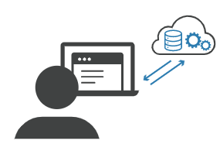
Software as a Service
zSaS can be connected and executed using the information provided by the zApp or zComponent and return the expected result
The developers of zApps or zComponents can develop zSaS, to provide optional added value
Software as a service approach, is licensed on a subscription basis and is centrally hosted
Notes:
zSaS can be connected and executed using the information provided by the zApp or zComponent and return the expected result. The developers of zApps or zComponents can develop zSaS, to provide optional added value, and then, they will receive a double income (zApp + zSaS). As the name suggests, it is a software as a service approach, and it is licensed on a subscription basis and is centrally hosted

Slide 27
ZDMP
IP MANAGEMENT

Slide 28
IP Management aspects
IP identification : All IP values within the subproject have to be identified
Results’ ownership: Reach an agreement with the other party in case of joint ownership
Protection of Results: IP protection is vital for a prospective commercial or industrial exploitation
Use of Results : There may be direct use, when the owner will industrially or commercially exploit the results , or indirect use, when they will transfer the result to other party
Dissemination: For the disclosure of project results owner are selecting the appropriate means
Notes:
Main IP Management aspects that should be considered are:
IP identification:. All IP values within the subproject have to be identified, listed, named and analysed, in a systematic way, in order to have a sort of project IP portfolio and map.
Results’ ownership: Identify the owners of the results andeach an agreement with the other party in case of joint ownership .
Protection of results IP protection vital for a prospective commercial or industrial exploitation, owner have to select the most appropriate and effective IP protection tool for every pieces of foreground, in accordance with the future planned use, in particular if direct commercial exploitation or further research will be preferred.
Use of foreground: there may be direct use, when the owner will industrially or commercially exploit the results (production and marketing of new products and services), or indirect use, when they will transfer the foreground to other party, that will exploit such results (e.g. by means of licences). Use will also consist in the utilisation of foreground in further research initiatives, aiming at the further enhancement of the developed outputs.
Dissemination of results: for the disclosure of project results owner are selecting the appropriate means (e.g. scientific publications, publication on web sites, conferences, open access, etc.).
You are required to disseminate project results as soon as possible and by appropriate means. However, keep in mind to protect any results that are capable of commercial or industrial exploitation before any dissemination activity.
order to create visibility for your achievements and to ensure knowledge spillover and access to a broader public, you may use a broad variety of different dissemination channels:
• Scientific and non-scientific publications
• Conferences
• Networking events and business fairs
• Project websites
• Communication material (such as posters, leaflets)
• Social Media
• Open Access

Slide 29
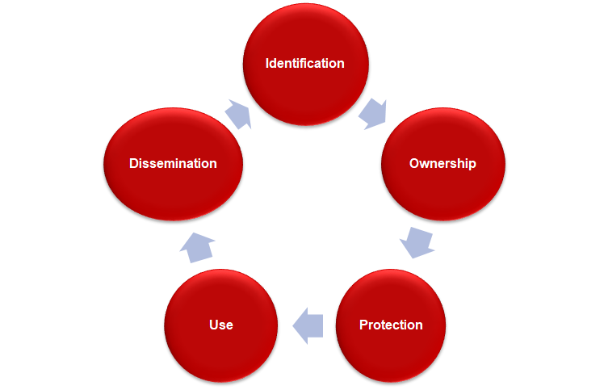
IP Management stages
Notes:
These are the IP Management aspects explained in the previous slide

Slide 30
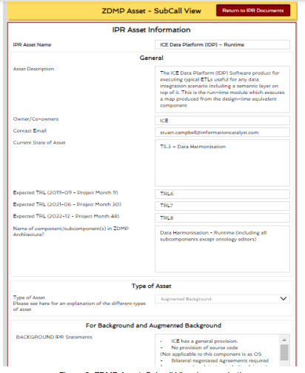
IP Repository
zdmp.eu/ipr-for-subcalls
The IP Repository at the ZDMP website is public so sub-call partners who may wish to review the IP protection of various components / assets) and project partners can access ito
Notes:
The IP Repository at the ZDMP website is public so sub-call partners who may wish to review the IP protection of various components / assets) and project partners can access it. In fact, the website has two views:
• Via the Publications menu which provides a full view of the IPR information and with suitable permissions allows editing
• Via the subcall menu which is a subset of the above information. For example, it does not refer to internal information of the project

Slide 31
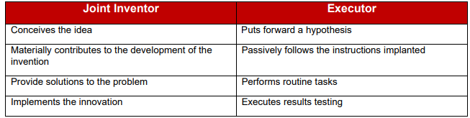
Joint ownership
Two or more beneficiaries owns results jointly
Owners may agree on the terms of the result of the joint ownership agreement
Only active contributions should be considered to create ownership
Notes:
Joint ownership of IP frequently arises in collaborative projects where more than one party involved. Two or more beneficiaries own results jointly when they have jointly generated them and is not possible to establish the contribution of each beneficiary or separate them for protection purposes. Only active contributions should be considered to create ownership since mere efforts,
assistance, and the sharing of ideas or information are insufficient
Owners may agree on the terms of the result of the joint ownership agreement (in an agreement known as joint ownership agreement) considering, for example, the following
• Allocation of the shares
• Conditions of the use and exploitation of the joint results
• Management of the jointly owned results

Slide 32
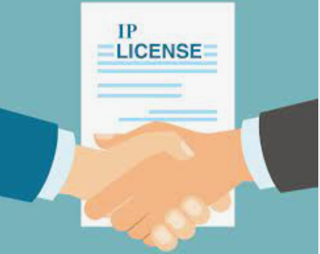
Transfer and Licensing
Transfer: Owners may transfer their economic rights to other parties willing to exploit their results
Licensing:
Open-Source Licensing: Open-source licenses fall within the framework of “none to some” restrictions
Proprietary Licensing: Use should be subject to the specific conditions decided by the owner
Notes:
There are different options regarding the IP exploitation rights of the results produced within the subproject
Transfer: Owners may transfer their economic rights to other partners that are willing to exploit the result (eg in joint ownerships, co-owners may transfer their IP rights just to one co-owner to exploit, or the owner (s) could also transfer their IP rights to another partner or an external party not involved in the project). In this case, the owner(s) decides under which conditions the transfer of rights is made
Open source: In these situations, the type of open source license of said zApp / component should be analysed, since open source licenses fall within the framework of “none to some” restrictions. For instance, under a Mozilla Public License (MPL), developers must make the source code for any of their changes available under the terms of the license. However, under an Apache License, developers are not required for any derivative work or modification to the original to be distributed under the same terms
Non-Open source: If a component is under a proprietary license, other non-open source license or another proprietary right (eg a patent). In these cases the use of the component should be subject to the specific conditions decided by the owner (eg limitation of use or modification restrictions or the obligation of paying a fee)

Slide 33

Conclusion
ZDMP offers great business opportunities to Sub-call winners to exploit their subproject’s results and interconnects different user’s groups enhancing exploitation opportunities
A thorough analysis of different aspects should be carried out to prepare your exploitation plan ( such as type of use of the results, customers segment, value proposition )
For a successful exploitation, it is essential to define an adequate IPR management strategy
Notes:
This part presents some conclusions related to the various contents of this module …

Slide 34
References
https://www.zdmp.eu/
https://www.zdmp.eu/ipr-for-subcalls
IPR Helpdesk (Guides): https://op.europa.eu/en/publication-detail/-/publication/bb7327c0-12a2-11eb-9a54-01aa75ed71a1/language-en/format-PDF/source-188386935
Your guide to IP in Horizon 2020: https://op.europa.eu/en/publication-detail/-/publication/e20da012-ec16-11e9-9c4e-01aa75ed71a1/language-en/format-PDF/source-164620712
Your Guide to IP Management in International Business: https://op.europa.eu/en/publication-detail/-/publication/bb7327c0-12a2-11eb-9a54-01aa75ed71a1/language-en/format-PDF/source-188386935
Notes:
This slide presents some of the references used to elaborate the materials for this training module.

Slide 35
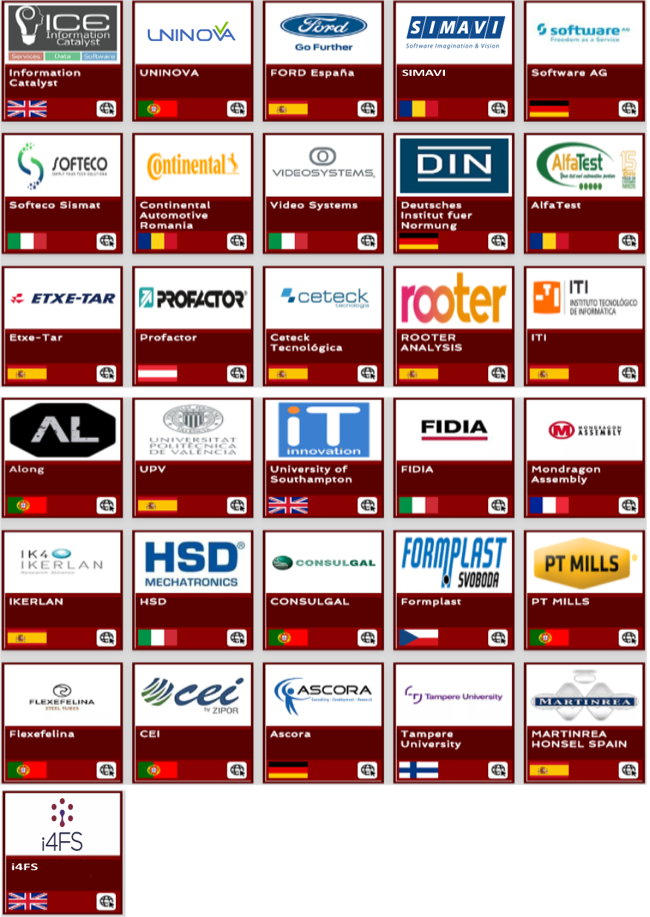
Thank You for watching
Funded by the Horizon 2020
Framework Programme of the European Union

