Slide 1



How to build zApps

Slide 2
Table of Contents
Introduction
ZDMP Components
ZDMP Applications
Implementation
Questions
Conclusion

Slide 3
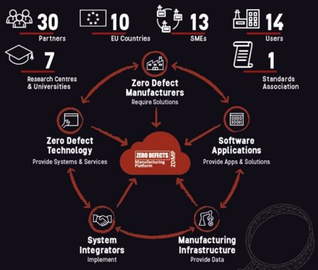
Introduction – ZDMP in a nutshell
Zero Defects Manufacturing Platform (ZDMP) provides a platform (a collection of software tools) that guarantees zero-defect in manufacturing. The platform consists of ZDMP components (zComponents) and ZDMP applications (zApps)
Through ZDMP, end-users can interconnect their systems (e.g., shop floor and ERP Systems) by using ZDMP Components (zComponents) and Applications (zApps), to improve product and process quality assurance

Slide 4
Introduction – ZDMP Components
What is a zComponent
A ZDMP Component is a software package , a web service, a web resource, or a module that encapsulates a set of related functions or data. It may run OnPremise, InCloud or both
It enables re-usability such that programmers can design and implement software, both zApps and further components, in such a way that many different programs can reuse them. It also allows interoperability with other platforms

Slide 5
Introduction – ZDMP Components
Some functionalities provided by ZDMP Components:
To build applications that monitor, manage, and control connected devices
To enable secure connectivity and privacy between devices and throughout the platform
To manage interconnectivity from device/sensors, to machines, to factories, to partners
To automate and provide services for the intelligent zero-defects ecosystem of the platform

Slide 6
Introduction – ZDMP Components
Typical examples of ZDMP Components include:
  Application Builder
  Distributed Computing
  Data Harmonisation
  Data Acquisition
  Secure Authentication/Authorisation
  Digital Twin
ZDMP provides an initial set of valuable components. This set will be improved over time. See (https://www.zdmp.eu/zdmp-components) for the full list of ZDMP components
A documentation regarding the use of every ZDMP component is available on (https://www.zdmp.eu/documentation)

Slide 7
Introduction – ZDMP Applications
What is a zApp
A zApp is an end-user solution running on factory servers, desktop or mobile clients. It may run OnPremise, InCloud or both
A zApp is developed utilising the project’s SDK and different ZDMP components (at least one zComponent in most cases). It will contain code, frontend (admin/user), backend, databases etc.
A zApp receives information from sensors/APIs and then processes the data. The data may be processed through Process and Product Analytics Services which in turn feeds back to the Apps to complete the cycle reiterating until the system is optimized

Slide 8
Introduction – ZDMP Applications
Typical examples of zApps include:
  zMachineAnalytics
  z3DGenerator
  zMachineMonitor
  zAlarm
  zParameterMonitor
  zDriver
  zPowerManager
ZDMP provides an initial set of valuable zApps, which will be improved over time. See (https://www.zdmp.eu/zdmp-applications) for the full list of zApps

Slide 9
Implementation – Energy monitoring zApp
The Energy monitoring zApp is developed to measure and monitor energy consumption in the FASTory assembly line in the experimentation facility
The energy monitoring zApp allows for the remote and real-time monitoring of the energy (ie power, current and voltage) consumption of the conveyor belt of the FASTory production assembly line. In addition, the application allows for the notification of abnormal measurements and initiation of automated processes based on the data
The conveyer belt has energy meters attached to it observing the consumption of power, voltage and current of the belt, which are the most vital measurements when it comes to predicting the condition of the belt based on the energy consumed

Slide 10
Implementation – Energy monitoring zApp
The conveyor belt aids pallet transportation from one workstation to another and if it loses its tension, the pallet transportation and the transportation time are significantly affected. The loss of tension reduces the belt life, and the belt may also brake
The belt repair may result in stopping the entire production particularly if the operations of the workstations are in sequence. It is therefore important to handle the gradual degradation of the conveyor belt tension beforehand to avoid any critical failures. The energy monitoring application detects anomaly related to the gradual degradation of the conveyor belt tension. This ensures in-time maintenance actions
The Energy monitoring zApp was developed using the Application Builder component (zStudio) and it utilizes other ZDMP components, namely: Data acquisition, Message bus, Monitoring and alerting, Secure authentication and authorisation, Secure installation, and Application runtime

Slide 11
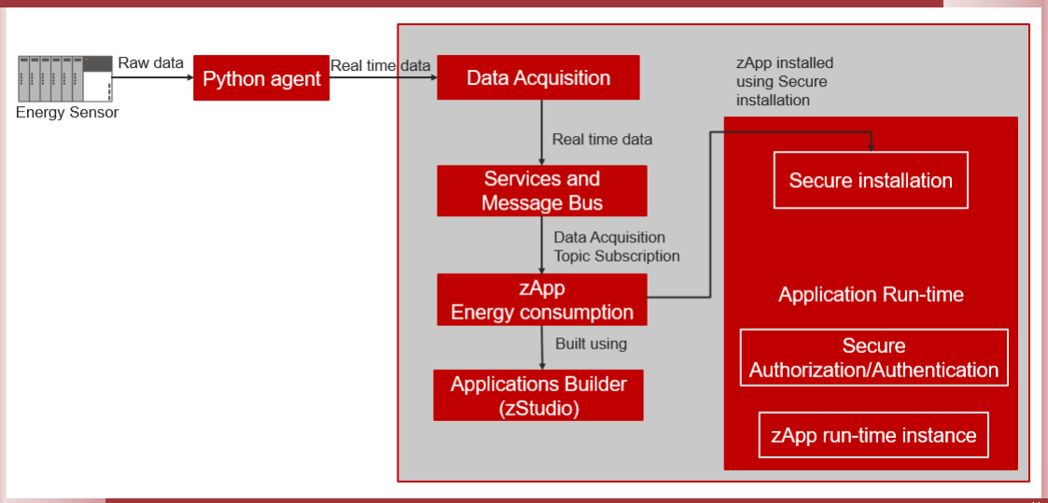
Implementation – Energy monitoring zApp
Architecture:
Fig. 1: Architecture of the Energy monitoring zApp

Slide 12
Implementation – Energy monitoring zApp
Components used and Role:
Components | Role
Application Builder (zStudio) | The UI of the energy monitoring application has been built based on the templates provided by the Application builder, which has also functioned as a tool for code customization. The Application builder allows integration of several other components, such as Monitoring and alerting and Secure authentication and authorisation, to the application with ease
Data Acquisition | The Data acquisition component provides APIs for registering devices on the Cumulocity IoT platform and acquiring data in different formats from various data sources. It also provides a UI for managing the devices and the incoming data. In the energy monitoring application, the data from the sensors at the experimentation facility is sent to the Data acquisition component by S-1000 computers through the APIs the component provides, and then published automatically in Message bus topic by the Data acquisition
Message Bus | Integration of the ZDMP Data acquisition component publishes the measurements on a Message bus topic, where any client with the correct credentials, and the topic name, can subscribe to that topic and access the data
Table 1a: Energy monitoring zApp – Components and role

Slide 13
Implementation – Energy monitoring zApp
Components used and Role:
Components | Role
Secure authentication and authorisation | The energy monitoring application has a login page to prevent unwanted users from accessing the sensible data. The authentication is based on JSON web tokens (JWT) and taken care of by the Secure authentication and authorization component
Monitoring and Alerting | One of the key functionalities of the energy monitoring application is to make it possible for users to define KPIs and attach alerts to them in such a way that the users would be notified if certain critical values in the incoming data are reached
Message Bus | Integration of the ZDMP Data acquisition component publishes the measurements on a Message bus topic, where any client with the correct credentials, and the topic name, can subscribe to that topic and access the data
Secure Installation | The energy monitoring application is deployed in the Application runtime through the Secure installation component
Application Runtime | The functional applications and ZDMP components are deployed in the Application runtime so that they can be accessed from anywhere - not only locally
Table 1b: Energy monitoring zApp – Components and role

Slide 14
Implementation – Energy monitoring zApp
App Building
The main ZDMP component required for the development of zApps is the Applications Builder component, which offers a set of functionalities to define, design, develop, and orchestrate manufacturing-related services. The Applications Builder provides an SDK (Software Development Kit), which is installed and used to develop them and in this case the energy monitoring application
The Applications Builder provides UI elements for applications design/development and a set of APIs for accessing other ZDMP components. Therefore, the implementation is on how to use the front-end UI editor (ie editors, compilers, builders etc) of the applications builder to design and develop the energy monitoring application. It also focuses on how to use the methods for accessing the functionalities of other ZDMP components, whose services the energy monitoring application depends on for its operation

Slide 15
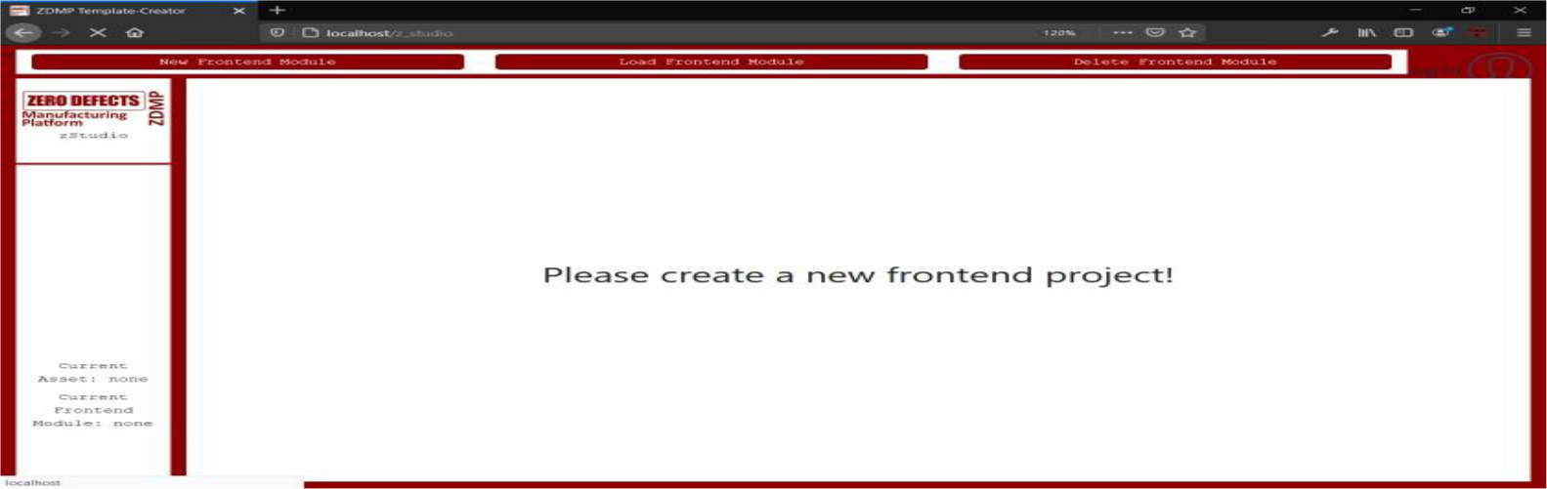
Implementation – Energy monitoring zApp
App Building
The Application Builder (See Figure 2 for GUI of zStudio) can be used either locally or on the ZDMP platform, meaning the deployed version of the component running at the Rancher cluster of the Application runtime
Fig. 2: Graphical User Interface for zStudio

Slide 16
Implementation – Energy monitoring zApp
App Building
To install the Application builder, see the related manual here (https://software.zdmp.eu/docs/components/developer-tier/application-builder/#installation). While developing an application with the application builder, users can use ready-implemented templates as a basis for their own development. The drag-and-drop type elements can be added to the pages of the zApp simply by clicking on respective buttons in the UI
To develop the energy monitoring application, the front page of the Application Builder was accessed and a new frontend module (i.e., the application template) was created by clicking on the “New frontend module” button in the top left corner (See Figure 3)

Slide 17
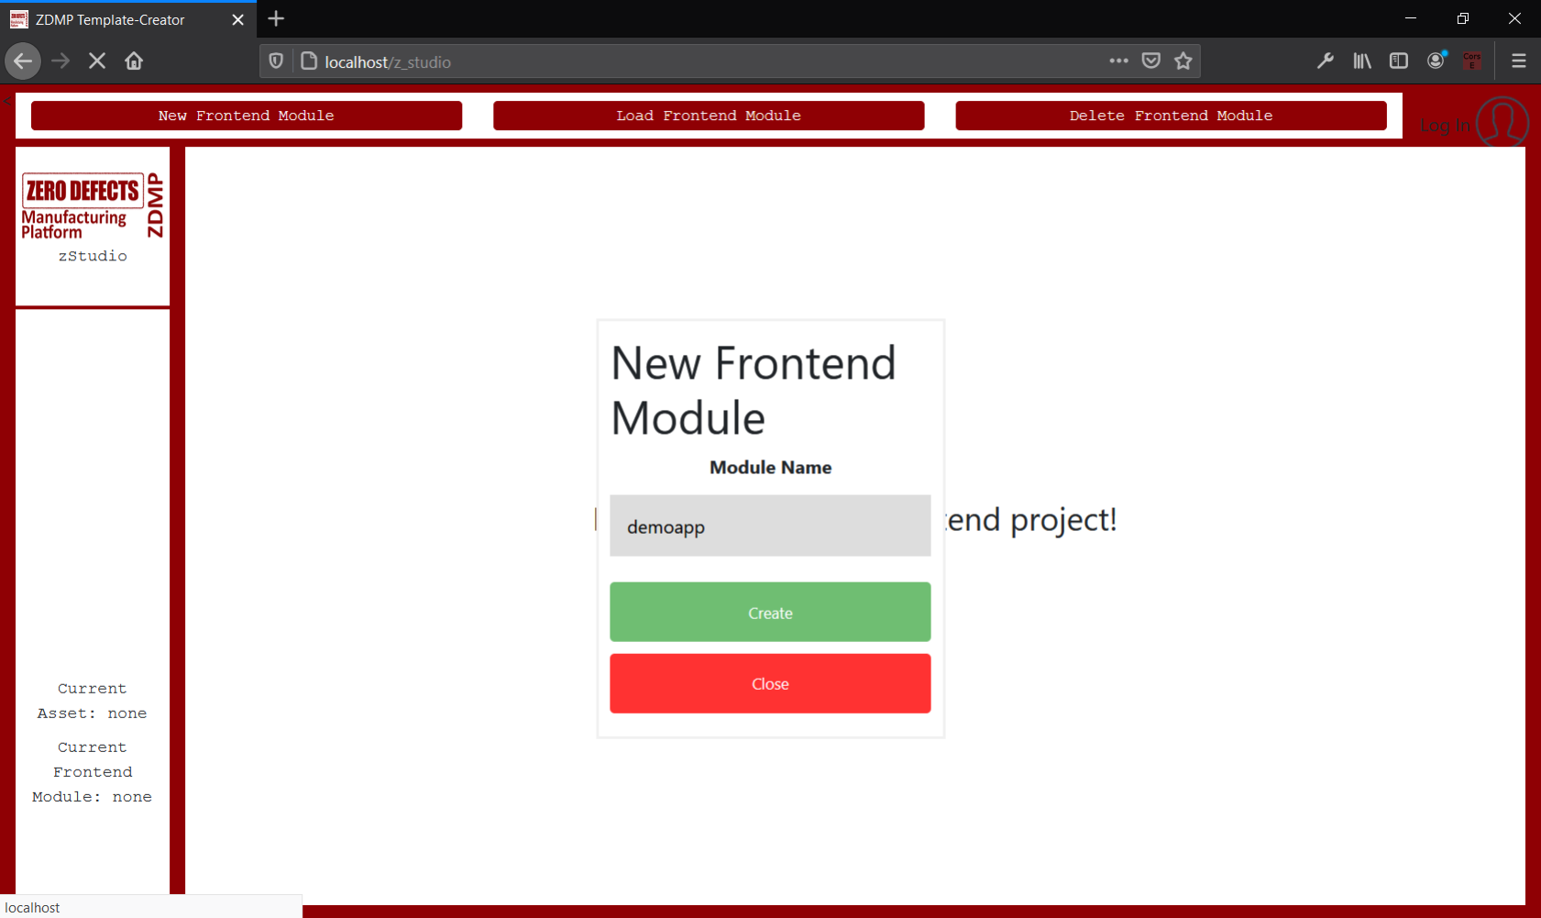
Implementation – Energy monitoring zApp
App Building
Fig. 3: Creating a new module on Application Builder

Slide 18
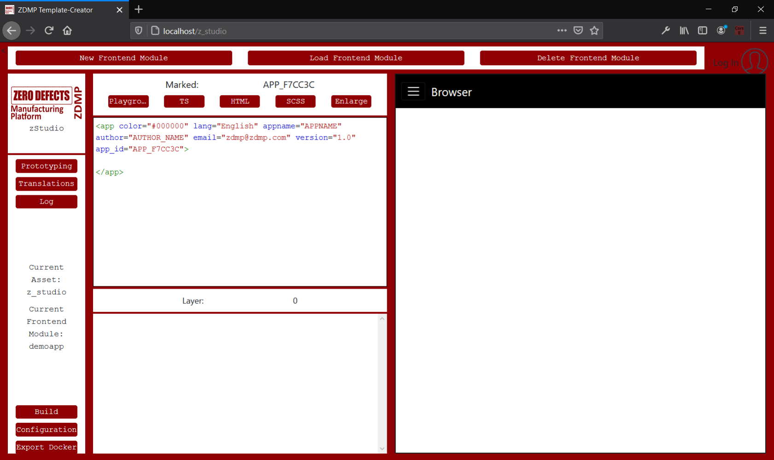
Implementation – Energy monitoring zApp
App Building
The module name was specified such that it contained only lowercase letters and then the “Create” button was clicked, after which the Application builder took few seconds to create an empty template as seen in Figure 4. At this stage, the prototyping view (the upper one on the left) contains only the <app> tag and an empty overview of the zApp. The template window is the lower one on the left
Fig. 4: Prototyping view after clicking on “create” button

Slide 19
Implementation – Energy monitoring zApp
App Building
The metadata of the application is modified by editing the attributes of the <app>-tag directly in the XML code. The version number can be left the way it is when building an application for the first time, but the author’s name and email need to be changed to correspond to the developer’s information.
Following the specification of the metadata, the zApp building can be initiated. The first step is to add pages to the application as seen in Figure 5. This is achieved by first clicking on the empty space between the opening and closing <app> tags in prototyping view. This makes “page” and “bug-report” buttons to appear in the template view below the XML-code. On clicking the “page” button, a <page> tag is added to the XML code

Slide 20
Implementation – Energy monitoring zApp
App Building
However, no changes take place in the preview unless the zApp is rebuilt. To build the application, the “Build” button on the left side of the UI has to be clicked and after some seconds, the application is built. The preview of the application then appears on the right side of the XML-code.
The preview is empty since no content was added to the added page. To create another page, the cursor can be moved outside the added <page> tag and then the empty space under the closing tag clicked. This procedure can be repeated to create further pages

Slide 21
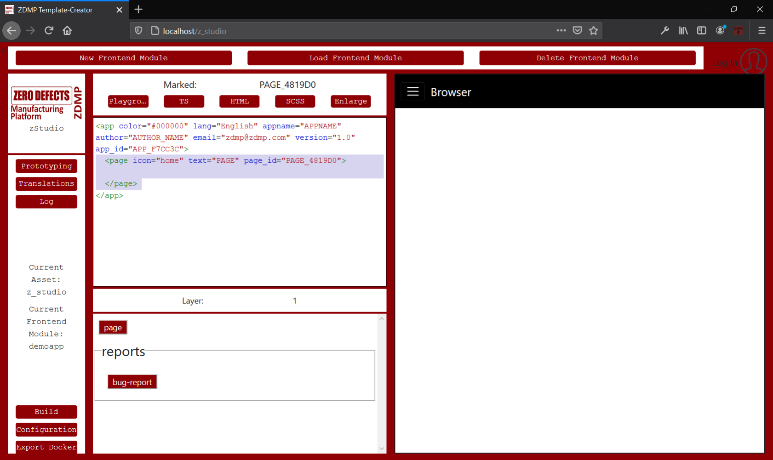
Implementation – Energy monitoring zApp
App Building
Fig. 5: Adding a page attribute to template

Slide 22
Implementation – Energy monitoring zApp
App Building
The next step is to change the names of the pages to more informative ones – by default, each page is named “HOME”, which can be seen from the prototyping view as the value of “name” attribute. To modify the name of a page, the <page> tag in XML is clicked, which then opens the attribute view of the element below, and at the same location on the UI which previously displayed the template view.
The new name of the page can be selected from the listed options, which include name template such as LOGIN or HOME, or it can be specified manually by directly editing the value of the name-attribute in the XML-markup.

Slide 23
Implementation – Energy monitoring zApp
App Building
The “build” process is initiated by clicking the “Build” on the bottom left once again (See Figure 6). Once the build is complete, the four added pages can be viewed from the main navigation of the application. In the preview, there is a button consisting of three lines on top of each other in the top left corner. By clicking the button, the user can navigate between different pages and see their titles.
To add content to the pages, the user navigates inside the Login-page by clicking inside the respective <page>-tag. By scrolling down to the user-management section and clicking the “login” button under it, a “login” form is added to the page. A developer can set the page to which the user is redirected after successful login by selecting appropriate page from the list of available pages. By rebuilding the application, the “login”-form appears on the preview-window

Slide 24
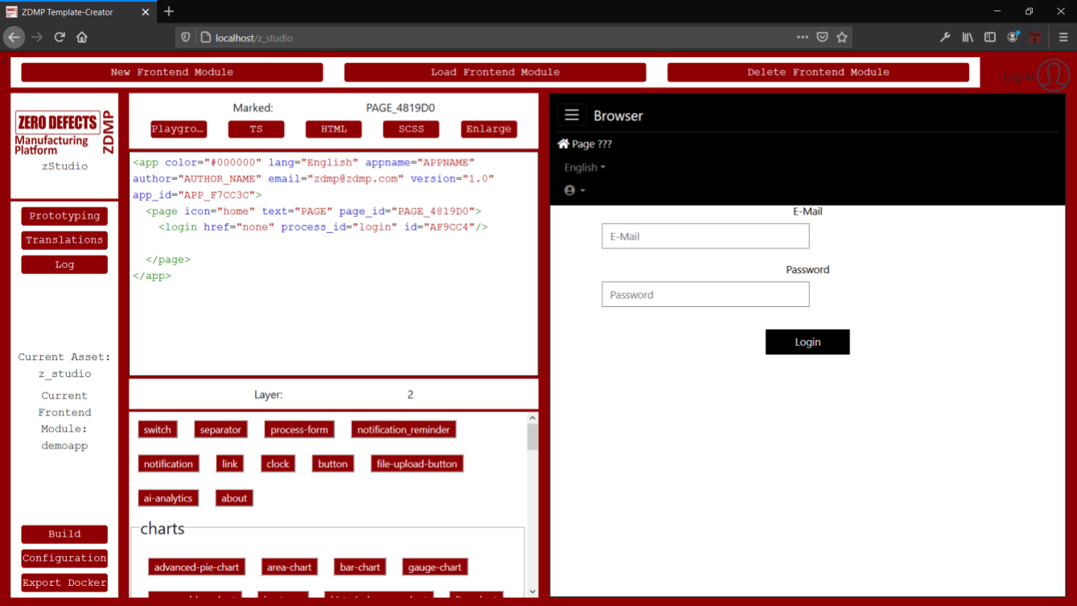
Implementation – Energy monitoring zApp
App Building
Fig. 6: Adding a login element and build of the zApp on the right pane

Slide 25
Implementation – Energy monitoring zApp
App Building
The Live measurements page (Figure 7 & 8) consists of a heading, message-bus integration and three (3) line charts displaying the data read from the Message bus. The message-bus section in the template view consists of four buttons, namely “subscribe-to-a-topic”, “unsubscribe-to-a-topic”, “last-message” and “publish-message”. The message-bus elements (buttons) were added in the sequence mentioned and the application was rebuilt.
These buttons allow users to subscribe to different topics selectable from the dropdown lists, unsubscribe to them, publish messages manually to any of the topics and to display the last sent message of a specific topic

Slide 26
Implementation – Energy monitoring zApp
App Building
After adding the Message bus elements, three line-chart buttons under the heading “charts” are added to the page. Their header contents are modified to correspond to the type of measurements to be displayed, for example, “Power measurements”, “Voltage measurements” and “Current measurements”.
The line charts have been implemented in such a way that they fetch the data from Message bus automatically, even though a couple of attributes need to be fine-tuned. However, before this is conducted, the application rebuilt to see empty line charts and to ensure that everything is working correctly. In addition, for the recent changes in the prototyping area to take effect, building the application is always necessary

Slide 27
Implementation – Energy monitoring zApp
App Building
Following this, the creation of the energy monitoring application is completed using just the templates provided by the Application builder and with minimal code customization. If the Application builder has been used locally, the source code of the application can be found from the folder subsystems/zdmp-application-builder/output/app_name, where the app_name is the name of the application specified at the beginning of the process.
In addition, the Docker image of the application can be exported by clicking on the “Export Docker”-button below the build-button. This builds the Docker image, taking around a minute, and can then be downloaded to the local machine

Slide 28
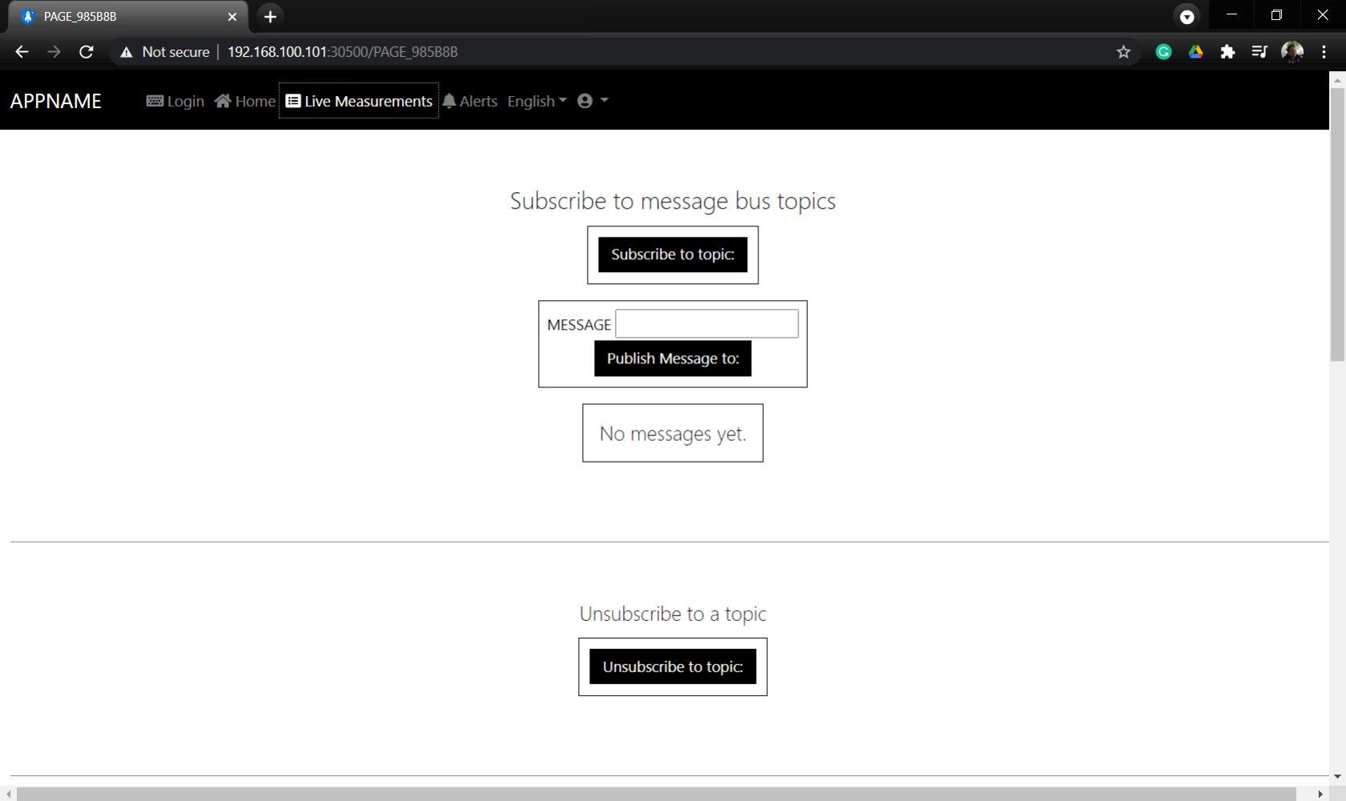
Implementation – Energy monitoring zApp
App Building
Fig. 7: Live measurements tab on the zApp page

Slide 29
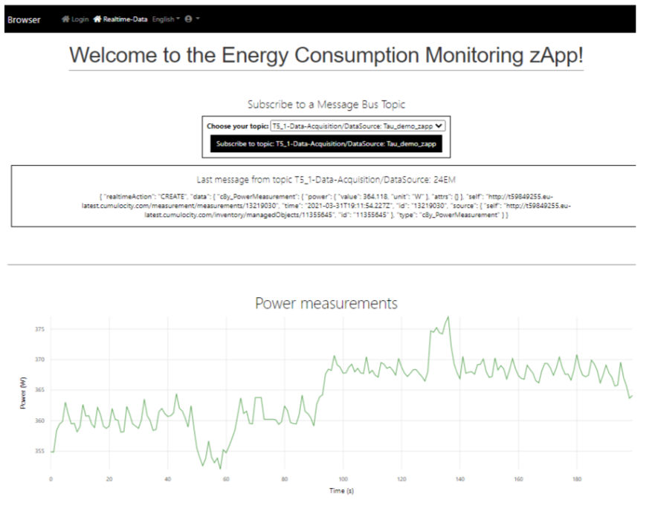
Implementation – Energy monitoring zApp
App Building
Fig. 8: Live measurements (Power measure) on the zApp page

Slide 30
Questions
Which ZDMP component is primarily for application design and development?
Message Bus
zStudio (correct)
Data Acquisition component
How many components was utilised in the development of the energy monitoring zApp?
8
6
7 (correct)
Which of these can be regarded as a ZDMP solution?
A zApp (correct)
A ZDMP Component (correct)
zApp and ZDMP Component (correct)
Notes:
In this slide some questions are asked to …

Slide 31

Conclusion
ZDMP provides a set of software packages (ZDMP solutions), which facilitates the development of end-user applications for guaranteeing zero-defects in manufacturing.
The Application Builder (zStudio) provides a means for application interface design and development.
zApps may run OnPremise, InCloud or both.
Notes:
This part presents some conclusions related to the various contents of this module …

Slide 32
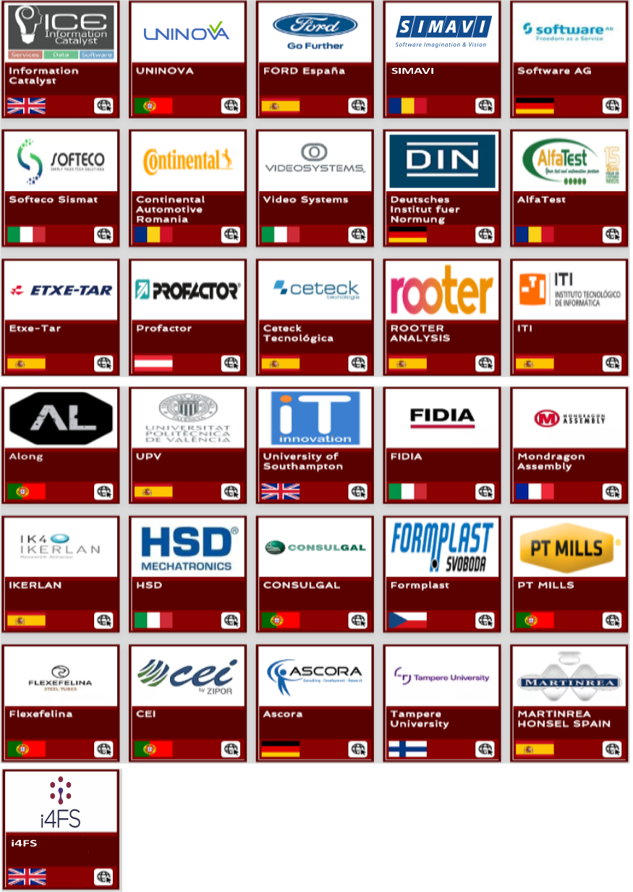
Thank You for watching
Funded by the Horizon 2020
Framework Programme of the European Union

